Slide 1
Training for Mentors
CUSP
Title IX: Sexual Misconduct and Dating Violence and Required Reporting
Summer, 2022
Columbia University
Marjory Fisher, Columbia University
Title IX Coordinator

Slide 2
Duty to Report Training Residential Counselors Academic Success Program’s Summer Bridge Program

Slide 3
Anyone know what Title IX is?
Notes:
Most will say gender equity in sports…which is still true. But now T9 has been re-interpreted to define discrimination as the creation of a hostile educational environment, when there is sexual violence, sexual harassment or dating or dv, or stalking…if any of these conditions exist, the University is tasked with eliminating it.

Slide 4
A review: Title IX. . .The Beginning
Notes:
Sports Illustrated cover from early 1970s…T9 then compared to T9 now

Slide 5
For example…Title IX and the Women’s World Cup in Soccer
Between the year Title IX was passed (1972) and the first Women’s World Cup (1991), the sport saw a 17,000% increase in U.S. girls playing on high school soccer teams, according to the National Federation of High School Assns.
Notes:
Consent is the backbone of our policy. This is our policy definition of consent, consistent with NYS law.
Columbia implemented an affirmative consent requirement before this recent legislation, it has simply now been codified for all institutions of higher education that receive state funds and directly incorporated (word-for-word) into our Policy.
Something similar to this on all campuses in the United States, due to guidance under T9

Slide 6
Title IX up until 2017
Title IX required that university policies prohibit certain behaviors and requires that colleges and universities do their best to ensure a “harassment-free environment.”
“When a school knows or reasonably should know of possible sexual violence, it must take immediate and appropriate steps to investigate or otherwise determine what occurred. Investigations must be prompt, thorough, fair, impartial and equitable.
If the investigation reveals…a hostile environment, the school must then take prompt and effective steps reasonably calculated to end the sexual violence, eliminate the hostile environment, prevent its recurrence, and, as appropriate, remedy its effects.

Slide 7
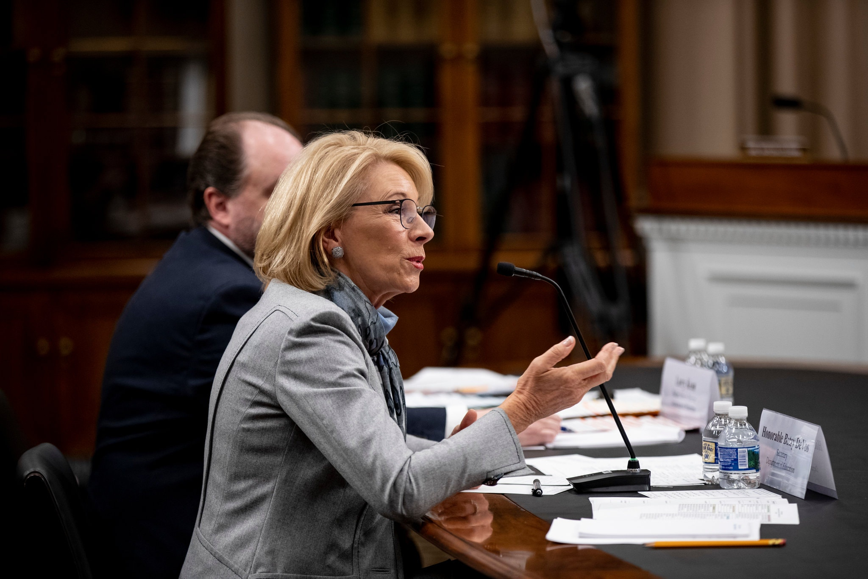
What’s Next?

Slide 8
Title IX 2.0…The next chapter

Slide 9
How do we find out when these things happen?
Reports by victim
Reports by others required to report
Anonymous reports
Reports by witnesses who may or may not have told the victim, or the perpetrator what they have seen

Slide 10
The Duty to Report: What you need to know.

Slide 11
Columbia’s Policy: Reporting Such Misconduct when Students are Involved
When prohibited conduct involves students, there are additional reporting obligations. The following employees, and you… have a duty to report any instance or allegation of prohibited conduct involving a student that is disclosed to, observed, or otherwise known by him or her whether the student is a Complainant or a Respondent:
Staff who work directly with students, including: teaching assistants, advising and residential program staff (including residence assistants and student affairs staff).
Faculty, Officers of Administration, Research, the Libraries and the Coaching Staff.

Slide 12
Those student facing employees are called “Responsible Employees”
Responsible employees include any employees who:
have the authority to take action to redress the harassment,
who have the duty to report sexual harassment to appropriate school officials,
or are individuals who a student could reasonably believe has this authority or responsibility.
New Trump regulations don’t require all of these people to report. We do.
Notes:
Defined in the OCR’s 2001 Guidance as someone who:
Has the authority to redress sexual assault or harassment; or
Has the duty to report sexual harassment or any other misconduct by students or employees; or
Is someone whom a student could “reasonably believe” has such authority or duty to report.

Slide 13
Who are Responsible Employees?
Academic Advisors
Student affairs staff
RAs
Student Peer Mentor Staff
Orientation Leaders during their term as Leaders
Admissions Staff
Deans
Officers of the institution
Faculty and TAs

Slide 14
You….
“In your capacity as mentor, you have a duty to report any instance or allegation of discrimination, discriminatory harassment, or gender-based misconduct you encounter, or are made aware of, upon the arrival of students to campus through the completion of your orientation program.”

Slide 15
What must be reported?
Any of the following cases involving students:
Sexual assault
Without affirmative consent
When someone is incapacitated
Gender-based violence
Sexual harassment/misconduct by an employee, towards and employee
Domestic violence, dating violence, stalking.
Discrimination
You are responsible employees and as such, you must refer these cases immediately to the University

Slide 16
Columbia’s policies: What type of behavior, exactly, is prohibited and therefore reportable?
You can find all policies – and the new Interim Title IX Policy--and all resources and policies on Columbia’s Sexual Respect website
www.sexualrespect.columbia.edu

Slide 17
Examples of what you need to know to determine if something is reportable
Affirmative consent = Yes means Yes*
How do you know if the other person has consented?
Your partner (hook-up, boy/girlfriend, spouse, or any other sexual partner) must clearly indicate,
through words or actions, that they are consenting to each type of sexual activity you engage in.
Silence or lack of resistance is NOT consent.
*For the full definition, see the Sexual Respect website.

Slide 18
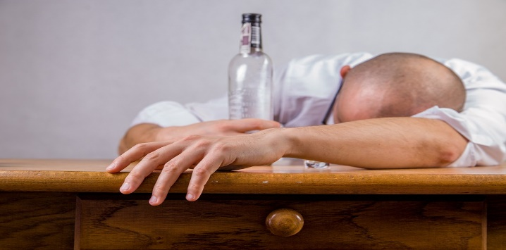
What about drinking, drugs and sex? Can there still be consent?
Someone cannot make rational, reasonable decisions if they are incapacitated by drinking, drugs or anything else. This is because they lack the capacity to give knowing consent (i.e., to understand the “who, what, when, where, why or how” of the sexual interaction)
If I have had a few drinks, can I still consent? Can my partner consent?
It depends! You can be tipsy or intoxicated and still able to consent, or incapacitated and almost unconscious, and unable to consent. Remember: if your partner has not affirmatively consented, that is sexual assault under Columbia’s Affirmative Consent policy (and NYS law).
What about “blackout”? “Blackout” doesn’t mean you can’t consent. It means that you can’t remember what happened.
It’s NO EXCUSE to say that you were intoxicated at the time and that you didn’t realize your partner was incapacitated!
Notes:
Ask for definition from group: difference between intoxication, incapacitation, and black out. It is a spectrum.
“Out cold” on the one end and “totally fine” on the other
Where is the line between the two?
How about on verge of losing consciousness?
How about enough drinks to be a little “high”?
When does impaired judgment become incapacitation?
Is it when you are “legally” intoxicated, i.e., over .08 BAC?
Intoxication is not the same thing as incapacitation

Slide 19
Will your student get in trouble with Columbia if they make a report to you about an assault but they were drinking/using drugs? NO! (of course, they should not be doing so during orientation programs!)
Columbia wants to be sure students are as comfortable as possible reporting incidents of sexual assault or other gender-based misconduct – including dating and relationship violence, stalking, and sexual and gender-based harassment.
We recognize that students who have violated the University’s alcohol or drug policies at the time of an incident may be hesitant to report an incident.
So, we do not discipline students for these violations if they report an incident that happened at the same time as drinking or drug use. (See the Sexual Respect website for the full Amnesty policy.)
Notes:
t’s important to note that we take this very seriously because our office adjudicates these non-GBM charges also and if you are talking to students who worry about this any may think that there will be an imminent investigation for drug or alcohol related events, you can calm their fears. Columbia has always practiced this, even though it is recently part of the Enough is Enough law.

Slide 20
What about sexual harassment?
Frequent question….
Is this something we should report?
If so, I am not so sure what it can look like.

Slide 21
Sexual Harassment: Two kinds
Unwelcome sexual advances, requests for sexual favors, and other verbal or physical conduct of a sexual nature are prohibited, when:
(Quid Pro Quo): submission to such conduct is made either implicitly or explicitly a term or condition of an
individual's employment or academic experience,
or status in a program or activity
Or as the basis for an employment decision
(Hostile work or educational Environment): such conduct has the purpose or effect of
interfering with the individual’s work or educational experience or performance;
of creating an intimidating, hostile, or offensive working or school environment;
or of interfering with one’s ability to participate in or benefit from a program or activity.

Slide 22
Examples of sexual harassment on an orientation or student activity.
Repeatedly showing around sexts a student’s partner sent him.
Telling homophobic jokes.
Asking overly personal questions about a new friend’s sex life.
Repeatedly requesting sexual interactions from someone who has told his new friend they are not interested.
Unwelcome hugs, massages, kisses.
Making a benefit in a student activity, or a class contingent upon a sexual favor.

Slide 23
Prohibited Romantic & Sexual Relationships
→ Faculty and staff may not engage in sexual or romantic relationships with undergraduate students.
→ Graduate students who teach, advise, or supervise undergraduate students may not have sexual or romantic relationships with any undergraduate students for any period of time that they have that role. → Faculty cannot be in a sexual or romantic relationship with a graduate student who is in any school, department, or program where the faculty member is connected, or with whom they engage in any direct or indirect way, or with any graduate student with whom they were previously connected. → Staff may not hire, supervise, employ, evaluate, advise, or mentor any Columbia student with whom they have - or have had - a romantic or sexual relationship. → Staff may not hire, supervise, employ, evaluate, or make decisions about salary for another staff member with whom they have or have had a relationship.
Why are you telling us this??

Slide 24
The Sexual Respect website (www.sexualrespect.columbia.edu) is your Go-To Resource
What if I want to report an incident, or if I don’t…I just want someone to talk to?

Slide 25
A student comes to me, tearful, says they need a few minutes to talk about something that happened last night...
You can anticipate what is coming
Explain your responsibility to report
Complainant says he/she wants confidentiality…direct the victim to confidential resources here.
If the victim says he/she wants to report, and wants something done, but wants confidentiality, tell the victim that their request will be considered, but no guarantees.

Slide 26
How do we explain this?
As you get to know me as [your OL, COOP/ISOP/CUE leader, RA] it's important that you understand my role. I am someone who is required to share information when disclosed to me about gender based misconduct or harm to self or others. I'll share with my supervisor or program advisor on a "need to know" basis in the hopes of getting you the most appropriate referral or resources."
"It seems you may be about to share something very personal, and I'm open to hearing whatever you are comfortable sharing with me- it's just important you realize I may not be able to keep what you share with me private. I work with a team of staff [in Res Life/Student Engagement/Multicultural Affairs] and may be required to refer you to appropriate resources.”
“Depending upon what you tell me, it is possible that the University may need to investigate, to make certain that you, and others are not at risk for this behavior. However, it is up to you to decide whether or not to participate.”

Slide 27
Support
Be patient, as it may be difficult for someone to talk about what has happened.
Be compassionate even if you do not fully comprehend all that someone is trying to tell you.
Be encouraging and give the individual as much space to say what they want and need to say in their own way.
If you encounter someone who is in need of immediate medical attention, call Campus Safety or 911.

Slide 28
Check Your Assumptions at the Door
The story makes no sense
I know this guy, he’s no rapist
I could tell she was making up the whole story just from the way she was acting
YOU ARE NOT THERE TO DO A FULL BLOWN INVESTIGATION!!
Not there to pass judgment.

Slide 29
Make the Call
Call your supervisor, and MAKE A REPORT (sexualrespect.Columbia.edu) as soon as possible and no later than 24 hours after you receive the information and relate what you know:
Name(s) of individuals involved
Date, time and location
Anything you were told about the incident
Your contact information
And remember, information shared with a faculty member is highly confidential and should be shared with no one else.
REMEMBER, YOU CANNOT NOTIFY LAW ENFORCEMENT WITHOUT VICTIM’S CONSENT

Slide 30
Should you be responsible employees?
Notes:
Why the controversy? And has the OCR taken a orientation leader one way or the other?

Slide 31
The Debate: Faculty/Advisors/Student Life Personnel as Responsible Employees
Pros
Casts the information-gathering “net” broadly
Facilitates the Title IX Coordinator’s job to keep campus safe
Ensures that complainants receive accurate information about their options
Avoids confusion
In line with “reasonable” student expectations

Slide 32
Who is a student going to tell?
You?
Or the Dean of their College?

Slide 33
The Debate: Faculty/Advisors/Student Life Personnel as Responsible Employees
Cons
Deters complaints
limits the student’s ability to “process/work through” the situation confidentially
Could inhibit learning or otherwise interfere with student-faculty bond (divides students and faculty/advisors)
Concern about personal liability
Concern about how to explain the Responsible Employee’s duty to report and the student’s options

Slide 34
What happens if I don’t agree to be a responsible employee in my capacity as a Mentor?
Failure to report or deciding NOT to report is a direct violation of the Columbia’s policy, and may lead to disciplinary action

Slide 35
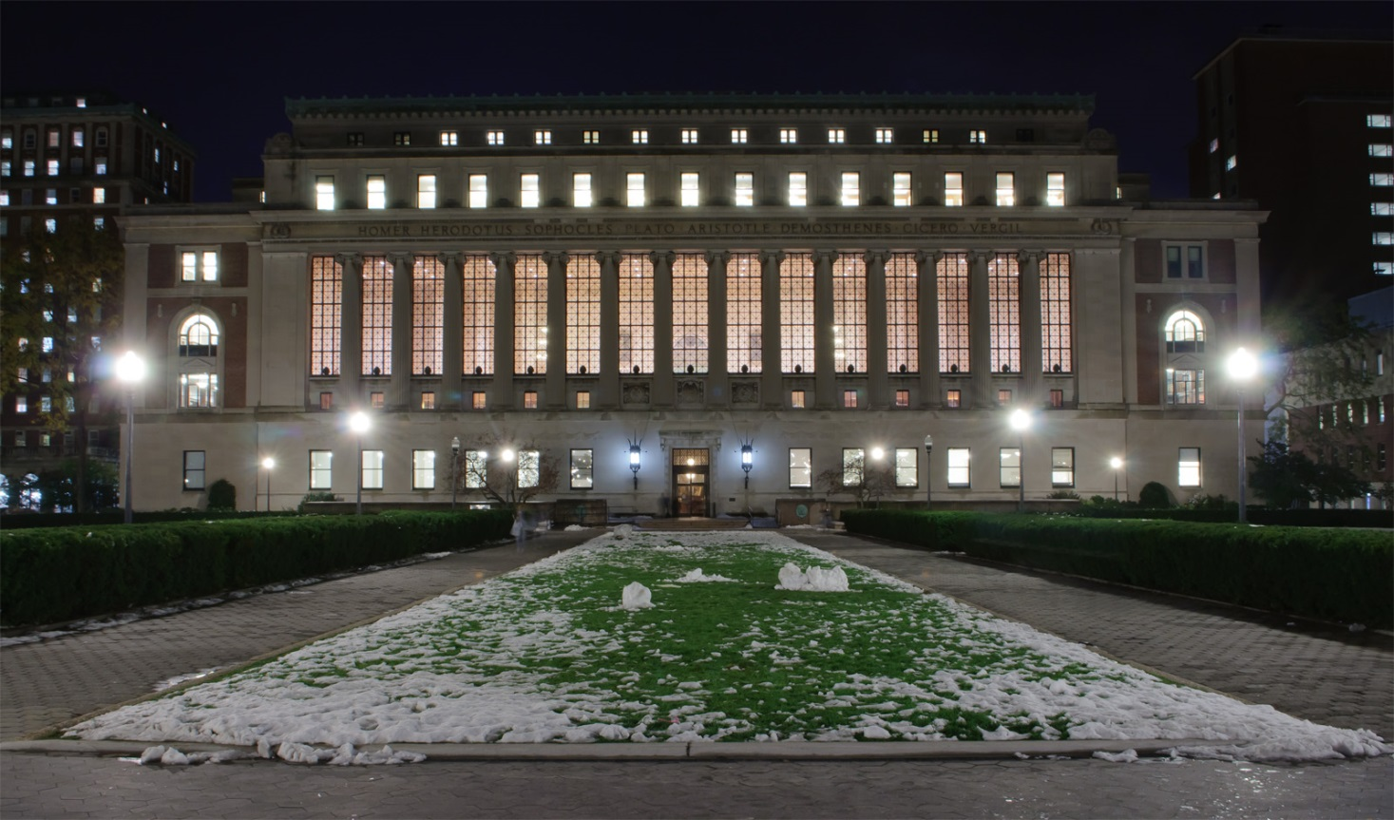
Resources and Reporting

Slide 36
How to Report an Incident
Violations of Gender-Based Misconduct Policy for Students
Gender-Based Misconduct Office: 212-854-1717
Sexual Respect at Columbia: www.sexualrespect.columbia.edu Click “Make a report”

Slide 37
Confidential and Additional Resources
Confidential University Offices/Staff
Counseling and Psychological Services
Medical Services
Clergy in the Office of the University Chaplain
Ombuds Office
Sexual Violence Response
Additional (Non-confidential) University Offices/Staff
Residential Life / Resident Advisers
Public Safety
Faculty
Academic Advisers
Deans of Students
Campus Administrators
Student Conduct and Community Standards
Orientation Leaders
Notes:
All of these offices are here to support you. Some of them may seem intuitive, other may not, so I will briefly explain them. First, the confidential resources are such because they have a professional duty to do so. Everyone else on campus, we are all here to help you, but if we receive this information, we have to do something with this information. It will remain private, but it has to be reported.
What is the Ombuds office? Ombuds office is confidential, impartial, informal, and independent. They have the authority to contact senior officers of the University, to gather information in the course of looking into a problem, to mediate or negotiate settlements to disputes, to bring concerns to the attention of those in authority, and to attempt to expedite administrative processes. The Ombuds Office does not conduct investigations.

Slide 38
What Happens After a Report is Received
Case Management and Community Engagement
Discuss resources and accommodations
Explain investigative and disciplinary process
Investigation
You have rights to a process
Adjudication
Sanctions (if found responsible) range from Warning / Education on the Policy, to Disciplinary Probation, to Expulsion
Notes:
Resource letter will be attached to initial outreach (or sent in case of in person meetings).
The first thing that happens is a case manager reaches out to provide support. We work with your Dean of Students and the other resources on campus to support you, whether you are a complainant or respondent
If something goes to an investigation, you have rights under that process, which is detailed in our process.
If a student is found responsible for a violation, there are serious outcomes. People are separated from the institution.

Slide 39
Last thing you need to know…

Slide 40
Enough is Enough…

Slide 41
Student’s Bill of Rights (there are 22)
All students have the right to:
1. Make a report to local law enforcement and/or state police;
2. Have disclosures of domestic violence, dating violence, stalking, and sexual assault treated seriously;
3. Make a decision about whether or not to disclose a crime or violation and participate in the judicial or conduct process and/or criminal justice process free from pressure by the Institution;
4. Participate in a process that is fair, impartial, and provides adequate notice and a meaningful opportunity to be heard
Notes:
These are attached to Columbia’s GBM policy, not all included here.

Slide 42
Student’s Bill of Rights
5. Be treated with dignity and to receive from the Institution courteous, fair and respectful health care and counseling services, where available;
6. Be free from any suggestion that the reporting individual is at fault when these crimes and violations are committed, or should have acted in a different manner to avoid such crimes or violations;
7. Describe the incident to as few Institution representatives as practicable and not be required to unnecessarily repeat a description of the incident;

Slide 43
Student’s Bill of Rights
8. Be protected from retaliation by the Institution, any student, the accused and/or the Respondent, and/or their friends, family and acquaintances within the jurisdiction of the Institution;
9. Access to at least one level of appeal of a determination;
10. Be accompanied by an advisor of choice who may assist and advise a reporting individual, accused, or respondent throughout the judicial or conduct process including during all meetings and hearings related to such process; and
11. Exercise civil rights and practice of religion without interference by the investigative, criminal justice, or judicial or conduct process of the Institution.

Slide 44
Additional Rights
The complainant must be notified of his/her right to "emergency access" to a Title IX Coordinator or other trained official who can advise of:
Options as to how to proceed
The importance of preserving evidence and of a sexual assault examination
That criminal and institution systems use different standards of proof and that questions as to whether the incident violated the criminal law must be made by law enforcement
Whether the official is authorized to offer confidentiality or privacy
Other options for reporting

Slide 45
Additional Rights
A right to access Columbia offices and resources that provide confidentiality versus privacy
If the accused is an employee, the right to disclose the incident to human resources or to have a confidential or private employee assist in reporting to human resources
To receive assistance from institution initiating proceedings in family or civil court
Information about available support resources, including whether they are free or for a cost
No contact orders, interim measures and accommodations to protect the reporting party, victim and community

Slide 46
What is all this really about?
Why is this really necessary?
Spread the information gathering net widely.
End the harassment
Prevent the harassment from happening again
Remedy the effects of the harassment

Slide 47
Responsible Employees Provide
• Control • Dignity • Choice
Eyes and ears in the Columbia community
A path for to provide resources and information for those who need it.
Support for the individual student’s decisions
If they come to you, they want you to help.
Notes:
Eyes and ears: : can alert Columbia that a member of the community is in need of assistance, or is a threat to the community
Title IX: Letting coordinator access students so she can provide info + resources
The individual can choose and decide for themselves what if any services, support or measures they would like to take to address and resolve the situation

Slide 48
Responsibilities of the Responsible Employee
Listen
Support
Refer

Slide 49
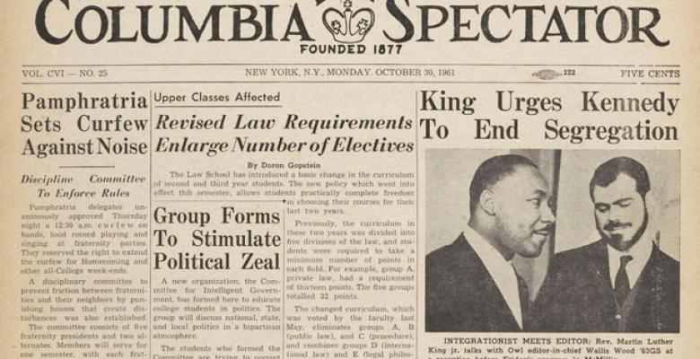
Leaders Speak Up
What about when I actually see something happening that involves a student who is being subjected to misconduct?
You see something, say something. You are leaders…don’t just be bystanders. Do something! You have a duty to act under Columbia’s policy.
Penn State: Penn State is the mother of all teachable moments for the bystander approach—men in powerful orientation leaders failed to act to protect children and said and did nothing.
Need people with guts and integrity to stand up in these situations and become leaders.
MLK: “In the end, we will remember not the words of our enemies but the silence of our friends….”
Notes:
Talking Points Taken from the following slides:
“How do the rest of us make a difference if we aren’t the victim or the perpetrator of sexual assault”
Bystander intervention
The “gold standard” in stopping the behavior before it is too late
A study of college students found that 68% did not know how to help a student in danger of being sexually assaulted
Of the respondents in the same study, over half (68%) of the respondents who knew a perpetrator did not confront the person about their behavior and or take any action
Taken From slide “An Example of what is being talked about on every college campus in the country
Expectation: That you step in when your team mates or your friends are in trouble
Being and having a good friend, or a good team mate, can be the best way to avoid getting victimized, or being accused of sexual assault.
Bottom line…If you see a team mate making sexual advances on someone who is intoxicated, or if you see someone doing this to someone on your team…. stop them

Slide 50
Expectations….for example
The orientation leader is expected to be an exceptional leader and mentor to the PROGRAM community, abiding by all University and School-specific conduct policies.
In your capacity as orientation leader you are expected to serve as a mandated reporter for any gender-based misconduct you encounter, or are made aware of, upon the arrival of orientation leader to campus on DATE OF ARRIVAL through the completion of PROGRAM on DATE OF CONCLUSION OF PROGRAM.
All PROGRAM-related activities, events and trips are considered alcohol-free, regardless of legal age.
Failure to meet any of these expectations may result in PROGRAM relieving you of your employment as an orientation leader.

Slide 51
What is “a high level of professionalism?” Remember, you are leaders and mentors…
During your tenure as NSOP leaders, the use or distribution of, alcohol or drugs to prospective students is prohibited.
You should refrain from engaging in any sexual behavior with prospective students while during your term as an orientation leader or during your trip.
All University regulations governing gender-based misconduct, including sexual assault, sexual misconduct and gender-based harassment apply.

Slide 52
Questions and Answers

