Slide 1
Columbia University Title IX Staff Advisors for Student Groups Spring, 2022
Marjory Fisher, J.D.
Columbia University Title IX Coordinator

Slide 2
Marjory Fisher
Title IX Coordinator, Columbia University since June 2016
Consultant to colleges and universities on the issues of sexual assault and domestic violence from 2013-2016
Served as Bureau Chief of the Queens District Attorney’s Office Special Victims Bureau for over 23 years
Investigated and supervised thousands of sexual assault, abuse and harassment cases and trained and educated innumerable attorneys, law enforcement officers, students, parents, faculty, health care professionals and the public at large
Published The Prosecutor’s Manual for Sex Crimes, a how-to guide for investigating and prosecuting sexual assaults
Served on the New York State Children’s Justice Task Force, the New York City Mayor’s Committee on Child Abuse and the Mayor’s Sex Crimes Task Force
Adjunct Professor of Law at St. John’s University Law School
Graduate of Indiana University and George Washington University’s National Law Center
National consultant on Title IX issues
Marjory Fisher
Associate Vice President &
Title IX Coordinator
Direct 212-853-1276
m.fisher@columbia.edu
Notes:
Speaker should insert own bio, and give warnings that some material covered in this presentation could be upsetting…so feel free to leave if you need to.

Slide 3
Today’s Objectives
Why do we train student leaders about Title IX?
Why?
What do the new Title IX regulations say about removing members without due process?
Notes:
Your team can be everything to you….
Best friends
Critical role in making you the best athlete you can be.
Athletes can be mentors, role models, and have credibility from Leadership in athletics and on campus…may be more successful in being active bystanders.
In this context, can also be the people that are there for you if you are heading into a dangerous situation.

Slide 4
First, what do we tell your student leaders?
What should you as student leaders be aware of when it comes to behavior prohibited under our Policy?
First things first, they have to know what it is to recognize it and do something about it.
Define prohibited behaviors so they know it when they see it.
Bust the mythology of the process.

Slide 5
I am hosting an event for my organization.
I see someone wasted, showing sexts of their partner (who is there) to a group of people, and being very handsy, while dancing. They then start asking one person to leave with them who seems to be very drunk. That person looks upset but can’t resist too much.
Group of members around them are laughing.
What to do?
I am the Club President and I have organized this.
Best response?
This is the third time for this?
Should I make a report?

Slide 6
What to do I do as a student leader when I see something like this unfolding at my org’s event?

Slide 7
Goals For Student Leaders:
Creating Cultures of Intervening
Supporting
and in some cases, Reporting
Role modelling for more junior members is critical

Slide 8
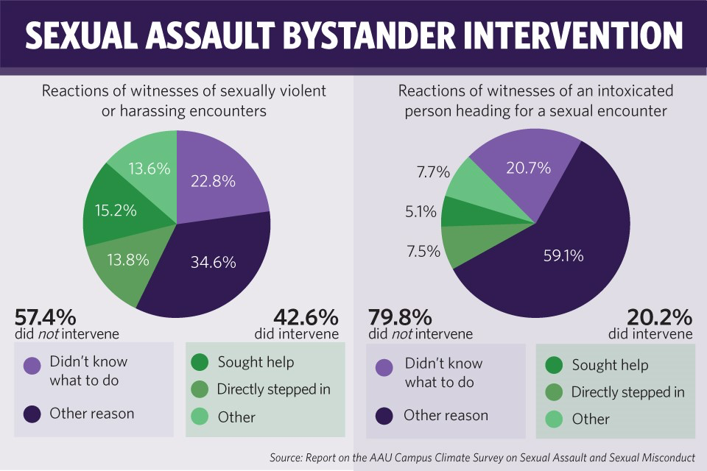
Notice the Problem and Step up
https://www.itsonus.org/educational-tools/videos/https://www.itsonus.org/educational-tools/videos/
https://www.itsonus.org/educational-tools/videos/

Slide 9
Best practices for Student Leaders
Modelling good by-standing by safely intervening

Slide 10
“About what you said earlier, I had a problem with it.”
Notes:
Outline: Part 3d, first section “5 D’s” Time: 3 min
Facilitators: Not everyone is comfortable intervening in the same way, and sometimes the situation dictates which approach would be most successful. What we are about to share is not a hierarchy – any of these approaches are appropriate
1. Direct- Confront the situation in the moment, e.g. you hear someone in your group making offensive comments “That’s offensive. You need to stop saying that." Or you notice someone getting upset after talking with another member of your group: “I'm noticing you seem upset after that conversation. Would you like us to check in briefly?”
2. Distract: Distraction is a subtle and creative way to intervene. Distract either person (the one who might be causing harm or the target of harm) with conversation unrelated to the situation to de-escalate it. Examples: Ask for directions, spill your drink “accidentally," pretend you know one of them. Student leader example: You are hearing two people possibly having a disagreement during a meeting, might say something like “I want to bring everyone’s attention back to the agenda," asking “everything going alright over there?” (not necessarily calling out anyone), drop something
3. Delay- Address the situation after the fact. Check in with the person who was harmed or address your concerns to the person who may have caused harm. Confronting them afterwards and in a different context from where it happened might also make them less defensive and more receptive to what you're saying
4. Delegate- Seek help from a third party (friend, Public Safety, MTA employee, etc.) Maybe you don't know the person well but there's someone in the group who does and could intervene with the individual in way that they trust
5. Document- Recording the offense, screenshotting messages
First, assess the situation. Is anyone already helping? If not, use one of the other four D’s. If someone else is already helping out, assess your own safety. If you are safe, go ahead and start document. ALWAYS ask the person who was harmed what they want to do with the recording afterwards. NEVER post it online or use it without their permission. There are several reasons for this.
Experiencing sexual violence is already disempowering
Using an image or footage of a person being victimized without that person’s consent can make the person feel even more powerless
It can also increase their risk of further harm or retaliation from the person who hurt them

Slide 11
Cultures of Support: Trauma-Informed
Their role
Recognizing trauma responses
Supportive conversations
Providing information and resources
Speak up to discuss with someone who has caused harm
Notes:
Now that we've talked about creating cultures of intervening, let's talk about the second key thing to work towards as a club leader, which is to create cultures of support. In doing so, we will consider your role, how to recognize trauma responses, tips for having supportive conversations, some key information and resources, and then also some tips for working with someone who may have caused harm

Slide 12
Cultures of Support: Trauma-Informed
Your role
Recognizing trauma responses
Supportive conversations
Providing information and resources
Working with someone who has caused harm
Notes:
Your role in these situations: listen, support, and refer
Positionality: Be mindful of the identities you carry and how they may impact your interaction with peers who come to you for support (or how your peers’ identities might impact their concerns and priorities)
One identity you all share is being in a position of authority within your organization - recognize that this creates a power dynamic

Slide 13
Notice the Signs
of Trauma
Crying
Depressed
Isolated or withdrawn: not responding to outreach
Increased substance use
Easily startled
Not acting like themselves
Erratic behavior
Notes:
Outline: Part 3, first section “Cultures of Support – trauma-informed” Time: 2 min
Facilitators: These are just some of the ways trauma may manifest for individuals. It's important to understand that these actions and behaviors on their own are not proof that someone is experiencing trauma or specifically trauma related to sexual violence, but rather that they are indications you may want to check in with the person to see how they're doing.

Slide 14
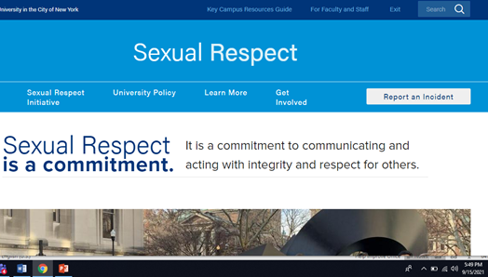
If you think a peer or a member may have caused harm...
Understand Your Role​
You are responsible for creating a welcoming environment for all members of your organization
You have an obligation to be impartial and support any student who approaches you in this capacity
Offer appropriate resources and be transparent if using them will trigger an investigation:​
Confidential Support:
Counseling and Psychological Services
Chaplain's Office
Ombuds Office
Investigation and Support:
Title IX Office
Student Conduct and Community Standards
Equal Opportunity and Affirmative Action
Notes:
Outline: Part 3, first section “If approached by someone who has caused harm” Time: 2 min
Facilitators:
As a leader, this is an opportunity to demonstrate the values of your club like respect, compassion, privacy, and helpfulness
Please note under confidential resources that Sexual Violence Response is not an appropriate referral for someone who is looking for support regarding an accusation or possibility that they have caused harm

Slide 15
How can you respond if someone tells you they have been harmed?
Understand Your Limits
Talk to your group’s advisor before taking any actions
Do not investigate or adjudicate. All parties have a right to formal due process as well as support and accommodations under Title IX
Moving to investigate or expel someone accused of causing harm increases the risk of further violence or retaliation towards the survivor. It can also put you/your group in violation of university policy
If you have safety concerns for you or someone else, inform your advisor or another Columbia employee
Acting on rumors can have a detrimental impact on both parties such as re-traumatization, financial repercussions, and loss of housing
The Sexual Respect website has resources and the university’s policies on misconduct
This is private. I won't share what you tell me with the rest of the group
Are you interested in getting some support?
If a report is made, there are more options than just having an investigation
Would it help if I walked with you to one of these offices?
Notes:
Outline: Part 3, first section “If approached by someone who has caused harm” Time: 4 min
Facilitators:
The only way a student’s access to a club can be restricted is if they are found “Responsible” through a formal investigation and hearing by the university
A note on retraumatization: If you are not trained in trauma-informed practices, questioning or acting on behalf of a survivor without their consent (even if it's well-intentioned) can be devastating and retraumatizing to them. Moreover, people who have caused harm may also have their own history of being harmed, and being questioned or expelled can be re-traumatizing (ex: later in "I May Destroy You," Kwame finds himself lashing out and mistreating another person who had no part in his trauma)
We want to acknowledge how difficult it must be for you all if there is pressure on you to take action such as kicking someone out of a group. If you are receiving pressure from others, explain the limitations of your role and also direct your peers to resources like the Ombuds office, Sexual Violence Response, or Title IX, where they can meet with the Title IX coordinator and/or make a report
And please remember that all the resources we've shared here are also available to you! If you want space to talk things out without triggering a mandatory report, you can connect with a confidential office like SVR, CPS, or the Ombuds office. If you have questions about policies, reporting, or the adjudication process, you can meet with the Title IX coordinator or reach out to Student Conduct and Community Standards

Slide 16
Why NOT just get rid of the perpetrator?
Problem won’t necessarily be solved when you throw someone out.
Sometimes, Need to change the culture of the organization.
If someone needs to go, don’t undertake the investigation yourself.
Remember, a perpetrator might hold their victim responsible for this and retaliation can get ratcheted up

Slide 17
Any problem with doing that under new Title IX regs?
Yes.

Slide 18
Best Advice—Move it from your plate to ours…

Slide 19
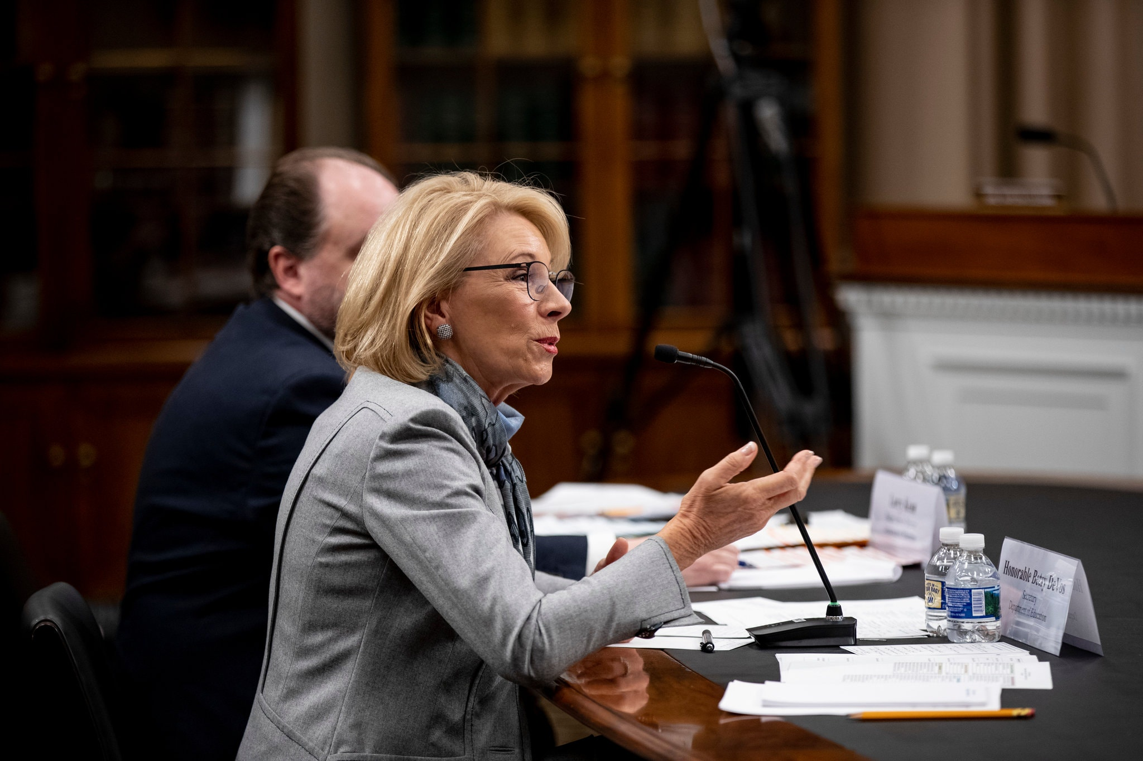
What’s Next? She’s GONE, But her rules are still here!!

Slide 20
Emergency Removal
Title IX Regulations § 106.44(c)

Slide 21
What did DeVos do about teams, clubs and orgs removing members before there is a University finding of responsibility?

Slide 22
Emergency Removal § 106.44(c)
Respondent may be removed from a club, team or off-campus entirely on an emergency basis (prior to adjudication/completion of the grievance process) “provided that the [University's] undertakes an individualized safety and risk analysis, determines that an immediate threat to the physical health or safety of any student or other individual arising from the allegations of sexual harassment justifies removal, and provides the respondent with notice and an opportunity to challenge the decision immediately following removal.”
Cannot remove someone any longer where threat is that a complainant will suffer emotional harm.

Slide 23
Emergency Removal: How do we determine immediate risk?
Nothing precludes a University from removing a respondent from the recipient’s education program or activity on an emergency basis, provided that the recipient undertakes an individualized safety and risk analysis, determines that an immediate threat to the physical health or safety of any student or other individual arising from the allegations of sexual harassment justifies removal, and provides the respondent with notice and an opportunity to challenge the decision immediately following the removal.
The preamble clarifies that “for purposes of responding to sexual harassment a recipient’s education program or activity includes circumstances over which the recipient exercised substantial control.” 85 Fed. Reg. at 30231.

Slide 24
The preamble to the final rule elaborates that this analysis must consider the particular respondent and examine the circumstances specific to the situation.
These circumstances can include “factors such as whether violence was allegedly involved in the conduct constituting sexual harassment, but could also include circumstances that ‘arise from’ the allegations yet do not constitute the alleged conduct itself; for example, a respondent could pose an immediate threat of physical self-harm in reaction to being accused of sexual harassment…
Ultimately, to make an emergency removal, the preamble explains, this individualized safety and risk assessment must yield “more than a generalized, hypothetical, or speculative belief that the respondent may pose a risk to someone’s physical health or safety.” Id.
The Department stated its belief “that further describing what might constitute an emergency would undermine the purpose of this provision, which is to set a high threshold for emergency removal yet ensure that the provision will apply to the variety of circumstances that could present such an emergency.”

Slide 25
When is an emergency removal allowed?
When there is an emergency situation that constitutes an immediate threat to the physical health or safety of any student or individual, and that threat arises from alleged conduct that could constitute sexual harassment as defined by the Regs.
No temporal restriction because risks arising from sexual harassment can occur at any time.
Identification of immediate risk is not limited to the details of the alleged sexual harassment itself — can also be related to the respondent’s post-incident actions or behaviors.
If a respondent’s actions pose an immediate and identified threat, but do not “arise from” allegations of sexual harassment as defined by the Regs (i.e. if they bring a weapon to school but unrelated to any sexual harassment allegations), § 106.44(c) does not apply and the university can respond under its regular code of conduct or applicable laws.

Slide 26
Whereas changing a respondent’s class schedule, housing, or dining hall assignment may constitute a permissible “supportive measure” depending on the circumstances, removing a respondent from the entirety of an institution’s education programs and activities — or even just one or more (such as removal from a team, club, or extracurricular activity) — would likely constitute an unreasonable burden on the respondent or be deemed disciplinary or punitive, and therefore wouldn’t qualify as a supportive measure.
Until and unless the grievance process has been completed, removals of the respondent from an institution’s education program or activity need to meet the standards for emergency removals under § 106.44(c).

Slide 27
Make the required findings:
● “Immediate threat”
○ The individualized safety and risk analysis must confirm that there is an “immediate
threat” justifying and compelling an emergency removal.
Things to consider:
■ The significance and weight that should be applied to a complainant’s
subjective fear of a threat versus an objective reasonable person standard.
■ The respondent’s propensity, opportunity, and ability to effectuate a stated or
potential threat.
● “To the physical health or safety of any student or other individual”
○ The immediate threat must be to the “physical health or safety” of one or more
people — can be the complainant, the respondent themselves, or anyone else.
○ Emotional/mental health does not count here; the Regs say that this can be
addressed by supportive measures rather than emergency removals.
○ Determination of “physical” risks of harm justifying an emergency removal should
be thoroughly evaluated and documented, especially in cases where there has been
no overt “act,” but rather speech, text messages, and/or virtual interactions.
● “Arising from the allegations of sexual harassment”
○ The emergency situation must specifically arise from the allegations of sexual
harassment.

Slide 28
Two students in student government are in a dating relationship. Sam accuses Jo of dating violence.
Officer in the student org asks Jo what happened. Jo is not ready to talk.
Board gets wind of this and tells Sam he must give up his position as Treasurer of Student Government.
Jo eventually makes a report.
Sam is ultimately found “Responsible.”
Can he be removed? When?

Slide 29
A member of a sorority alleges they were assaulted by Richard at a fraternity.
President of the frat hears about this.
His friend Richard is accused.
Asks alleged victim about this; they don’t say much.
Others come forward with complaints involving Richard the same night..
Weeks later, after their own “mini-investigation” Richard is told they are “unwelcome” in the frat going forward, Richard leaves.
Everyone knows, no one makes a report.
Any issues with the frat’s action here?
Later, Richard shows his friend a plane ticket from that night; flew to his grandparent’s funeral. Was not there.

Slide 30
Someone tips off the frat’s advisor
Any action necessary on your part?

Slide 31
Outdoors club VP knows of 2 women who say they were sexually assaulted at a party last month while on a camping overnight.. Max is accused.
After learning about 2 of them, VP decides not to make a report, or to alert the advisor.
Why did he decide not to make a report?
Consequences to the two women if a report is made?
Must they participate in an investigation?
After no report made, 3 more women are assaulted.

Slide 32
Better outcome?
Report made
Investigated fully
Given due process
Action taken.

Slide 33
Myths I hear often:
He was so drunk that the next morning, it won’t be a big deal.
If I, student leader make a report, I am taking the “agency” away from the victim, and I will be plunging her into a never-ending morass where she will she will spending the next 6 months in reporting hell.
He doesn’t want him to get into any trouble; it was in the past, why do something weeks later?
There are no other options other than suspension or expelling someone, right?
A NCD means I can’t go to a party where they might be, right?

Slide 34
No Contact Directive (NCD)
In an attempt to de-escalate discord, promote civility, and ensure the well-being of all parties involved, while a
resolution option is under consideration, and while the University continues to reserve its right to review
matters to ensure an appropriate resolution, given information known to Student Conduct and Community
Standards (“SCCS”) , SCCS is implementing the following No Contact Directive (“NCD”), effective
immediately:
John Doe is prohibited from contacting you until further notice. Such prohibited contact includes, but is not
limited to: personal contacts, written communications, text messaging, social media and other electronic
communications, and communications through a third party, whether on or off the Columbia University
campus, which may be considered in conflict with the spirit of this directive.
John Doe has been notified of these directives. In addition to the above, we also ask that you refrain from any
contact with Mr. Doe as detailed above. Failure by either party to comply with any of the above directives
will result in disciplinary action.

Slide 35
Does not mean you can’t be at the same place.
Simply means you should not interact.

Slide 36
Remember, tell them to take it off their plate…and put it on ours!

Slide 37
And if YOU find out about it, make a report.
➔Duty to Report
The University requires Columbia employees to report any instance or allegation of prohibited conduct involving any undergraduate or any graduate student that is disclosed to, observed by, or otherwise known to that employee whether or not the student is a potential Complainant or Respondent and whether or not the student has any formal connection to the employee.

Slide 38
Martin Luther King, Jr….

Slide 39
Questions?

