Slide 1
Title IX and
Pregnancy Accommodations
Columbia School of Nursing
2023
Marjory Fisher, JD
Title IX Coordinator
Columbia University
Notes:
Introduction: each presenter introduce self, their office and what it does.
This is the point where we normally give the sensitivity trigger warning.
What I am going to do today is:
Fly through a brief overview of our policy and what we normally tell students and other staff. I’m not going to get too wrapped up in definitions of sexual assault.
What I want to do is take you through a bit of what happens when we get a report. We are going to stress the case management function, but we will talk a bit about the actual investigation without getting into the weeds.
c. Our colleagues in EOAA will later talk about their office, which also deals with Gender-Based Misconduct but under different circumstances

Slide 2
Anyone know what Title IX is? A brief history lesson…
Notes:
Most will say gender equity in sports…which is still true. But now T9 has been re-interpreted to define discrimination as the creation of a hostile educational environment, when there is sexual violence, sexual harassment or dating or dv, or stalking…if any of these conditions exist, the University is tasked with eliminating it.

Slide 3
Title IX. . .The Beginning
Notes:
Sports Illustrated cover from early 1970s…T9 then compared to T9 now

Slide 4
Title IX and the Women’s World Cup in Soccer
Between the year Title IX was passed (1972) and the first Women’s World Cup (1991), the sport saw a 17,000% increase in U.S. girls playing on high school soccer teams, according to the National Federation of High School Assns.
Notes:
Consent is the backbone of our policy. This is our policy definition of consent, consistent with NYS law.
Columbia implemented an affirmative consent requirement before this recent legislation, it has simply now been codified for all institutions of higher education that receive state funds and directly incorporated (word-for-word) into our Policy.
Something similar to this on all campuses in the United States, due to guidance under T9

Slide 5
This includes a prohibition on…
Discrimination against pregnant students, female athletes, discrimination based upon gender orientation and against transgender students and prohibits gender-based misconduct, including sexual assault, sexual harassment, dating and domestic violence, and stalking.

Slide 6
Title IX. . .Then
Title IX requires that university policies prohibit certain behaviors and requires that colleges and universities do their best to ensure a “harassment-free environment.”
“When a school knows or reasonably should know of possible sexual violence, it must take immediate and appropriate steps to investigate or otherwise determine what occurred. Investigations must be prompt, thorough, fair, impartial and equitable.
If the investigation reveals…a hostile environment, the school must then take prompt and effective steps reasonably calculated to end the sexual violence, eliminate the hostile environment, prevent its recurrence, and, as appropriate, remedy its effects.
Withdrawn, as of September, 2017…changes have arrived.

Slide 7
No More…SVU

Slide 8
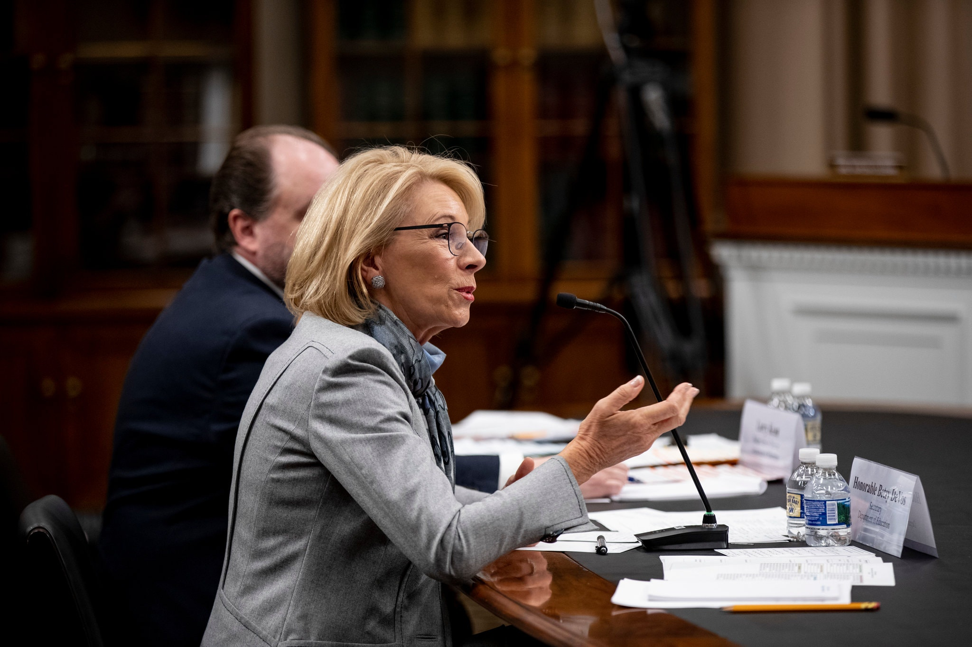
What’s Next? She’s GONE, But her rules are still here!!

Slide 9
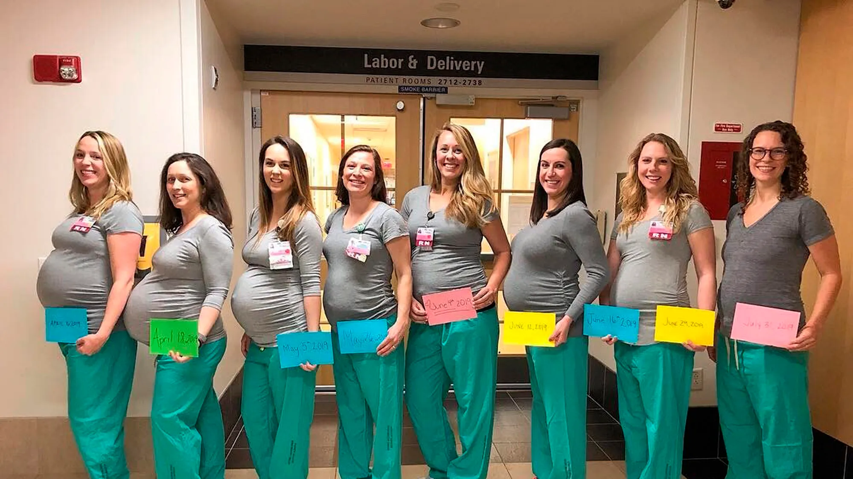
She DID NOT change the rules around accommodating pregnant students.
Biden has proposed new rules.

Slide 10
Title IX and Pregnancy Discrimination
Pregnancy discrimination is explicitly prohibited in federal regulations under Title IX.
• Pregnancy discrimination is a form of sex discrimination because only women can become pregnant. • Pregnant women must be treated the same as other students with temporary medical conditions that require treatment.
Pregnancy is NOT usually considered a disability so Columbia DS does not handle these requests. • Institutions cannot unilaterally presume what limitations (if any) should be placed on a pregnant woman’s participation.

Slide 11
Title IX: Regulatory Language
Recipients of federal funds “shall not apply any rule concerning a student's actual or potential parental, family, or marital status which treats students differently on the basis of sex…[and] shall not discriminate against any student, or exclude any student from its education program or activity, including any class or extracurricular activity, on the basis of such student's pregnancy, childbirth, false pregnancy, termination of pregnancy or recovery therefrom, unless the student requests voluntarily to participate in a separate portion of the program or activity of the recipient.”
34 C.F.R. § 106.40

Slide 12
What does Title IX have to do with Pregnant students?

Slide 14
What do we have to do for our Pregnant students?

Slide 15
How much Time Do they get to take off? Most do not want to take a semester off.

Slide 16
What kind of leave should we be allowing?
School by school determination
Disability leave
Abide by any written policies you have on the amount of leave available for nursing students
Most don’t want it.

Slide 17
We also do this…..

Slide 18
Proposed Regs…more specific

Slide 20
At Columbia, over 300 Pregnant students helped with accommodations

Slide 21
Department of Education Office for Civil Rights issued a Report: “Supporting the Academic Success of Pregnant and Parenting Students”
Addresses issues of assistance, program progression, and leave:
Adjustments may be required to ensure access to the educational program (e.g., restroom breaks, larger desks).
A student must be reinstated to the status she held when leave related to pregnancy began.
Excused absences for medical reasons.
Exceptions for late work and class attendance or participation credit.

Slide 22
In Admissions..
When making a determination about admissions, institutions cannot:
Apply any rule which treats persons differently on the basis of sex;
Discriminate against or exclude an applicant on the basis of pregnancy, childbirth, termination of pregnancy, or related recovery; or
Establish or follow any rule or practice which discriminates on the basis of pregnancy, etc.
Institutions must treat impairments related to pregnancy in the same way and under the same policies as any other temporary impairment or physical condition.
34 C.F.R. § 106.21

Slide 23
Or in Employment…
Institutions “shall not discriminate against or exclude from employment any employee or applicant for employment on the basis of pregnancy, childbirth, false pregnancy, termination of pregnancy, or recovery therefrom.” 34 C.F.R. § 106.57

Slide 24
Financial aid
When awarding financial aid, institutions cannot, on the basis of sex or pregnancy:
Provide different amounts or types of financial aid
Limit eligibility for assistance
Apply different criteria
Discriminate based on marital or parental status

Slide 25
What to Do?
Work with pregnant and parenting students individually and come up with an academic plan tailored to each student’s needs and focused on academic success.
Advise pregnant and parenting students of the availability of programs and services to help them stay in school and maintain their educational progress.
Tell them to call us, and register with Title IX.
Next steps.

Slide 26
https://universitylife.columbia.edu/content/accommodations-pregnant-students

Slide 27
What NOT TO DO
Don’t assume what pregnant students can do or cannot do.
Don’t tell students at admissions interviews, or at orientation or in advising that they should NOT GET PREGNANT.
Don’t rely on “drop one test” rules to accommodate students.

Slide 28
Amount of LEAVE GENERALLY ACCORDING TO DISABILITY LEAVE: SCHOOLS DETERMINE
ACCOMODATIONS DURING PROEGNANCY WE WORK WITH YOU, AND WITH STUDENTS IN TANDEM
“REASONABLE ACCOMODATIONS”
DURING PREGNANCY, AND SHORTLY AFTER BABY COMES

Slide 29
What are Parenting Accommodations?
Department of Education Guidance states:
Should have some policies that allow parenting students to take leave time or make up hours for “parenting students (both male and female) who need to take their children to doctors’ appointments or to take care of their sick children.”
Department of Education Guidance encourages schools to “designate a private room for young mothers to breastfeed, pump milk, or address other needs related to breastfeeding.”
Make sure you make the list of lactation rooms available.

Slide 30
OCR Investigations on these Cases on the increase
• Recent increases in OCR complaints that mention pregnancy may lead to increased enforcement efforts from the Department.
From 2009‐2012, complaints to OCR raised the issue of pregnancy or parenting‐related discrimination 59 times
From 2013‐2016, the issue was raised 138 times.
OCR Investigation: Saddleback College (September 2015) School of Nursing clinical instructor gave student failing grade and allegedly told student to “retake the class when she was no longer pregnant.”
(The regulations, at 34 C.F.R. §106.40(a), state that recipients may not apply any rule concerning a student’s actual or potential parental, family, or marital status that treats students differently on the basis of sex. 34 C.F.R. §106.40(b) states that, generally, recipients may not discriminate against any student or exclude any student from its education program or activity on the basis of the student’s pregnancy or childbirth. Resolution: The Recipient, without admitting any violation of federal law, voluntarily agreed to enter into the attached Agreement with OCR to resolve the complaint. The Agreement requires the Recipient to draft written guidance and conduct training on the Recipient’s nondiscrimination policies and regulations and with respect to its responsibilities for investigating complaints of discrimination, complete a formal investigation of the Complainant’s sex discrimination complaint, and to reenroll the Complainant in the Recipient’s nursing program.

Slide 31
Suggestions
Be aware that students do NOT have to identify as pregnant, even if obvious.
Students must choose to voluntarily identify.
Tell students that if they become pregnant, they can share and then we will support them, and get them accommodations necessary to succeed.
Communicate what we can do, don’t assume knowledge
Be clear about program requirements, make sure students know that they will be restored to the position they were in when they left and will not be penalized.
Must make up work.

Slide 32
What do we tell the Students when they ask for Accommodations?
Many options:
Request a leave and will be re-instated to position they were in when they left (BUT DO NOT TELL THEM THAT THEY MUST TAKE A LEAVE!)
Continue with accommodations
Accommodations will depend on the nature of the academic work.
Papers, quizzes, tests can be made up later.
INCOMPLETES ARE AVAILABLE
Clinical rotations, group projects, lab work may require more creativity when determining how (or whether) to accommodate a student.
Determine in consultation with faculty.
Check‐in requirement with student prior to accommodations expiring or student returning from leave.

Slide 33
Accommodations Leave of ABSENCE
Relieved of full time duties
Extension of coursework or certain academic responsibilities
Eligibility clock extended
Financial support remains intact
May be altered
Relieved of all responsibilities
Stops coursework/academic requirements
Stops eligibility clock
May forgo financial support entirely
May have timeframe governing return

Slide 34
Don’t assume your institution can make decisions about what the student can or should and cannot or should not do!
For example…

Slide 35
What Evidence of Medically Required Absences is the University able to Require?
University, through Title IX Coordinator, can ask for medical note for pregnancy-related absence.
If a student wakes up with morning sickness and misses class, it is not reasonable to ask them to call their doctor every time for documentation.
Instead, the student can provide documentation from the doctor saying the student is prone to morning sickness and may have the occasional need to stay home. Look at what is reasonable for the student to get.

Slide 36
Can a school require a pregnant student to obtain THEIR MD’s permission before allowing her to attend school late in her pregnancy if it is worried about student’s health or safety?
You can’t do that unless it is something you would do for other kinds of temporary medical conditions, and usually it’s not.
General concerns that someone may “go into labor” are not sufficient.
It has to all be about how any temporary medical condition is treated – it can’t be about fear of pregnancy!

Slide 37
Scenarios: Complications

Slide 38
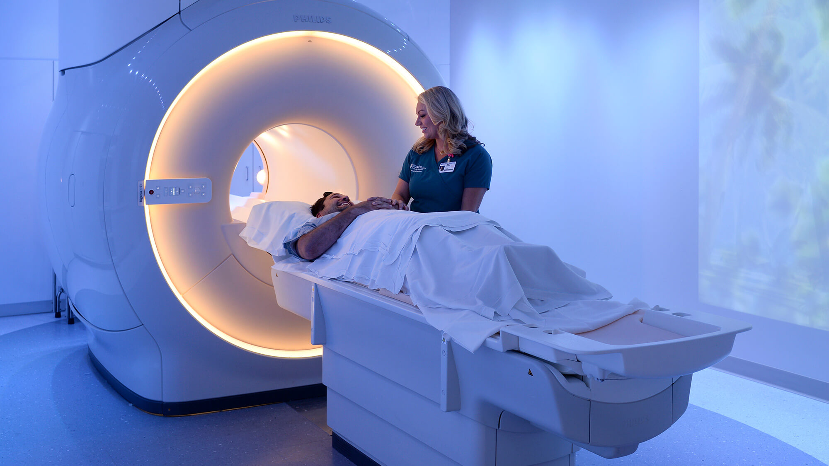
Scenarios: THE MRI SUITE
Radiation Scenario
Can you tell a pregnant student they cannot work in a hazardous environment?
You can advise them of the risks.
You can get them a position where the risk is not the same but there are learning opportunities
Can school require pregnant students to wear personal protective equipment while inside labs or other hazardous environments?
You can always have a uniform requirement (for everyone).
Everybody, pregnant or not, wears protection from x-rays.
You should be careful about requiring only pregnant students to wear protective equipment because we would need a strong position on that re that condition vs. other medical conditions.
It has to be consistent without how other medical conditions are treated.

Slide 39
Covid and pregnancy: What is Reasonable?
For pregnant students worried about covid: In the past, generally accommodated absence due to COVID risk.
Not vaccinated likely cannot enter areas for clinical work regardless.
If it’s a short period, zoom/recordings might work, but generally not for the whole course.
Must be “reasonable.”
Look at what is reasonable before deciding:
Can participation be facilitated?
Not reasonable in a clinical setting?
How much participation happens in the class?
What to do about group projects where presentation is in class?

Slide 40
Refresh: Frequent Requests for Pregnancy Accommodations that we routinely accommodate
Missed classes
Delayed exams
Recording of lectures or zoom
Notes taken for student by a note-taker during discussions/lectures
Extra time to complete papers
Slight adjustments to degree requirements
Missed exams? Skip policy must be applied to pregnant students equally. (i.e.. must give a make-up if student wants it!)
Lactation Space

Slide 43
And then there are these Requests….
What bus should I take when I am pregnant?
Where can I nap?
With whom can I leave the baby?
Can you do my laundry?

Slide 44
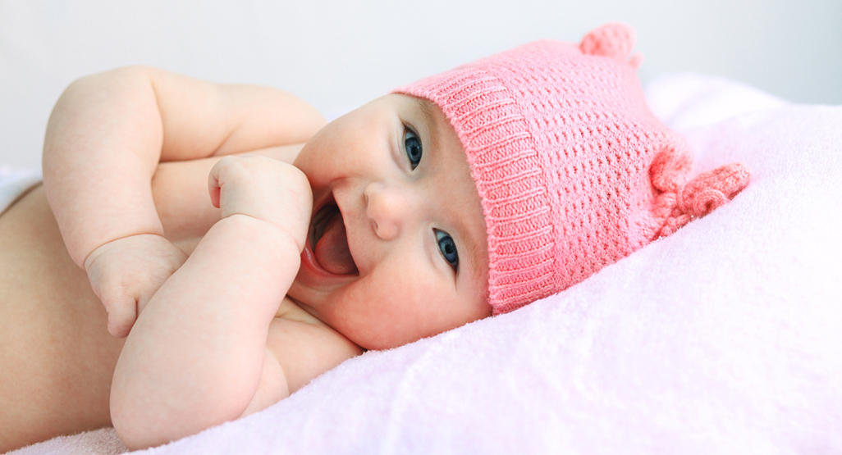
Questions and Answers

