Slide 1
Columbia University Title IX Investigator training 2022-23
The 2020 Title IX Regulations and Beyond….

Slide 2
Topics for Discussion
2020 regulations: most pertinent background and definitions
Focusing on conduct, not gender
Conducting Investigations:
Impartiality: avoiding prejudgment, conflicts of interest, bias
“Directly related” and “relevance” concepts
Creating investigation reports
Potential impacts of trauma on memory
Introduction to witness-centered interview concepts
Ensuring that witness-centered investigation approaches are applied in a manner that is demonstrably balanced, thorough, and fair to all parties

Slide 3
How did we get here?
From Title IX’s passage to Columbia’s Current Policy….

Slide 4
Title IX. . .The Beginning
Notes:
Sports Illustrated cover from early 1970s…T9 then compared to T9 now

Slide 5
Title IX. . .2011
Title IX requires that university policies prohibit certain behaviors and requires that colleges and universities do their best to ensure a “harassment-free environment.”
“When a school knows or reasonably should know of possible sexual violence, it must take immediate and appropriate steps to investigate or otherwise determine what occurred. Investigations must be prompt, thorough, fair, impartial and equitable.
If the investigation reveals…a hostile environment, the school must then take prompt and effective steps reasonably calculated to end the sexual violence, eliminate the hostile environment, prevent its recurrence, and, as appropriate, remedy its effects.
Withdrawn, as of September, 2017…changes have arrived.

Slide 6
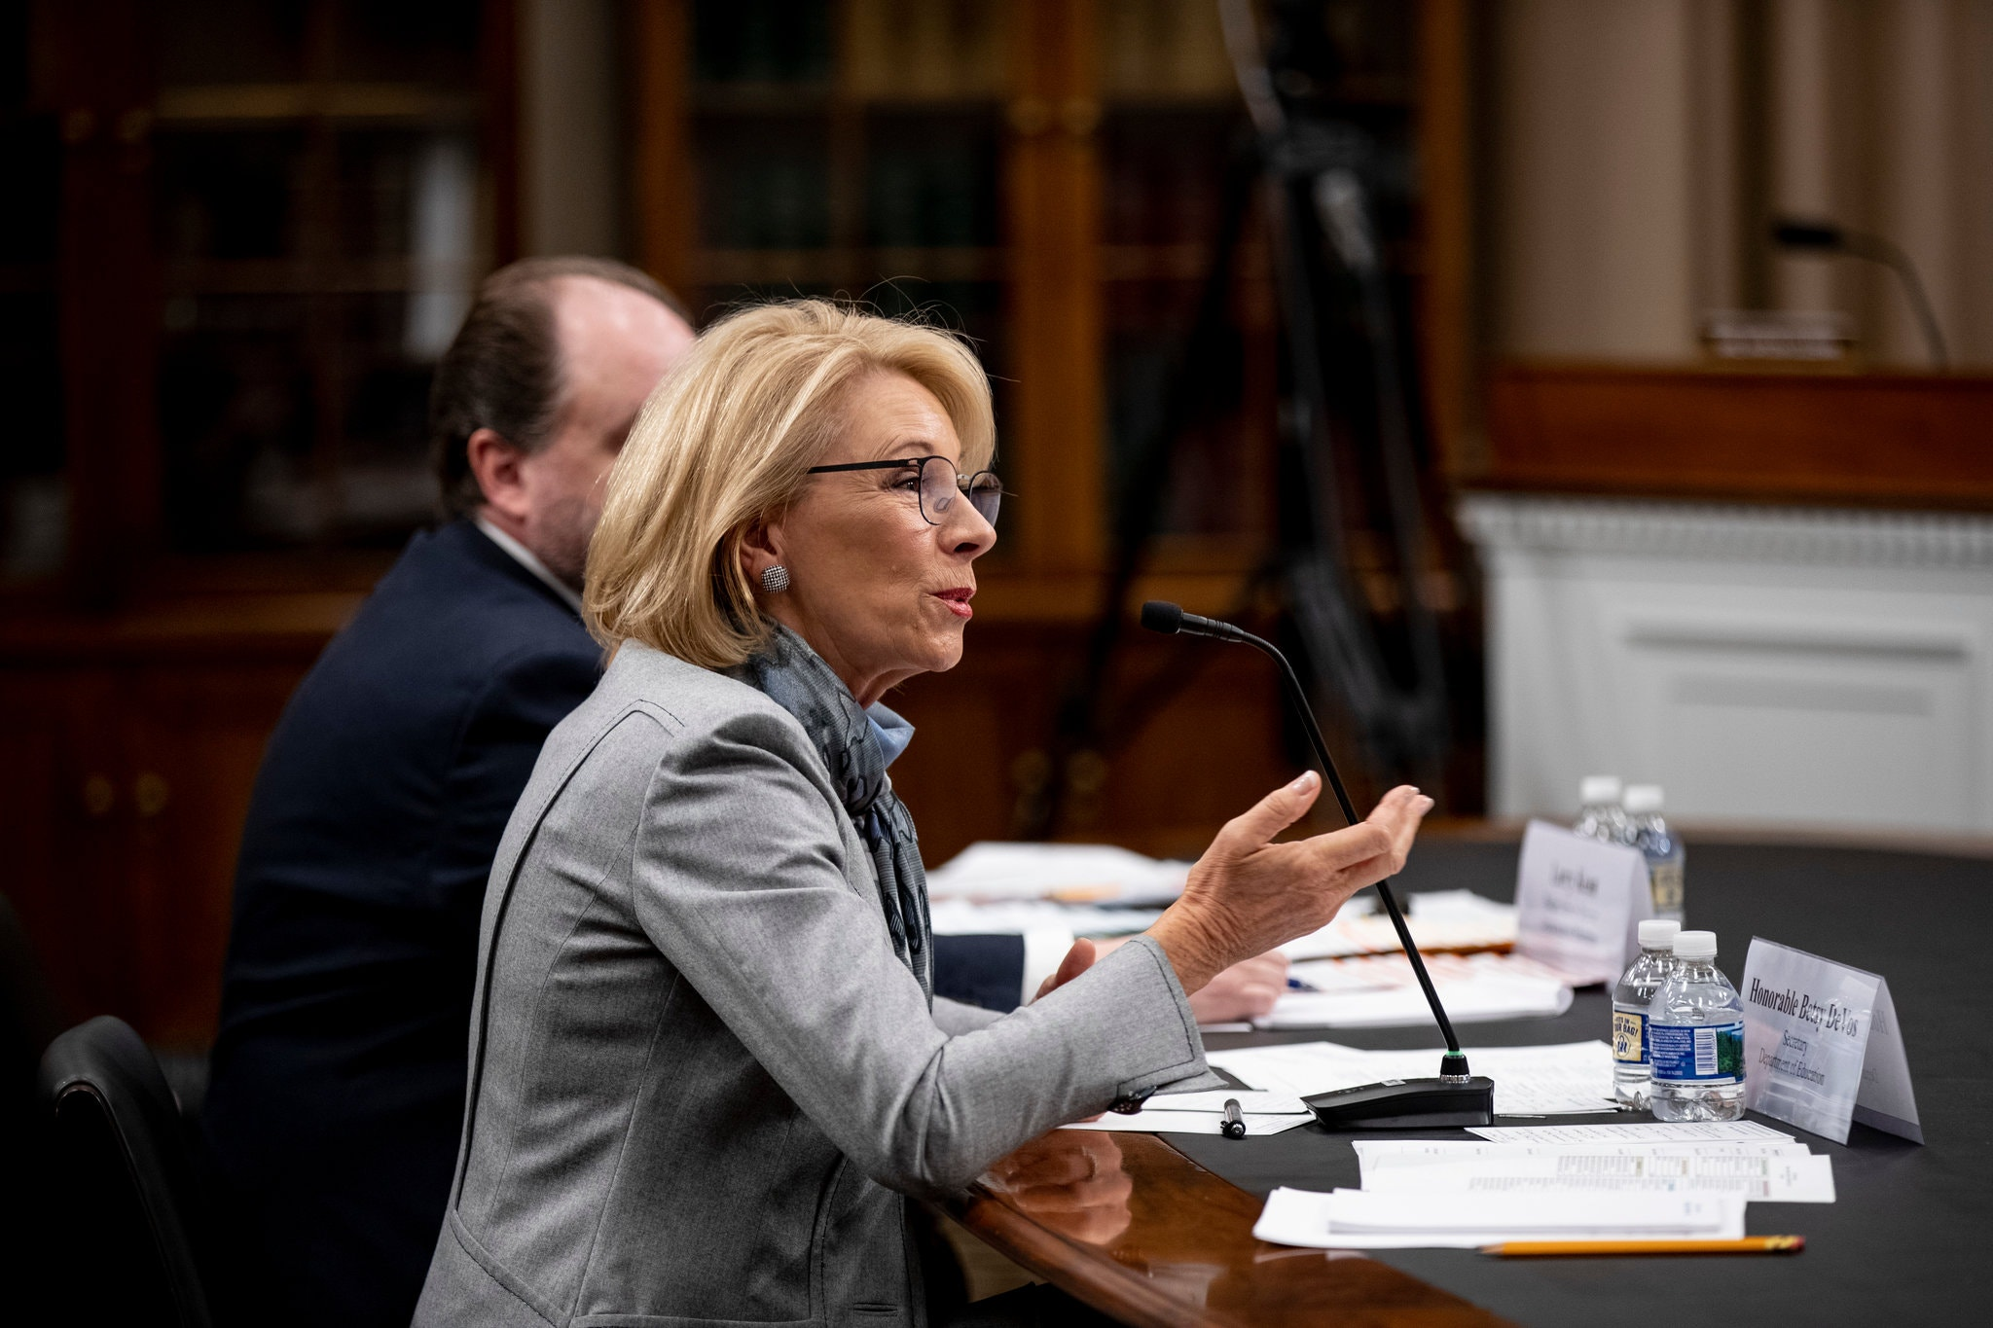
What’s Next? She’s GONE, But her rules are still here!! (limits on jurisdiction and increased procedural rights)

Slide 7
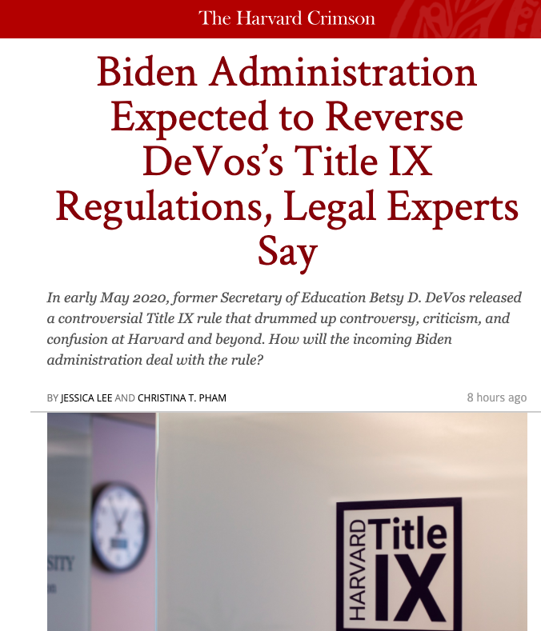
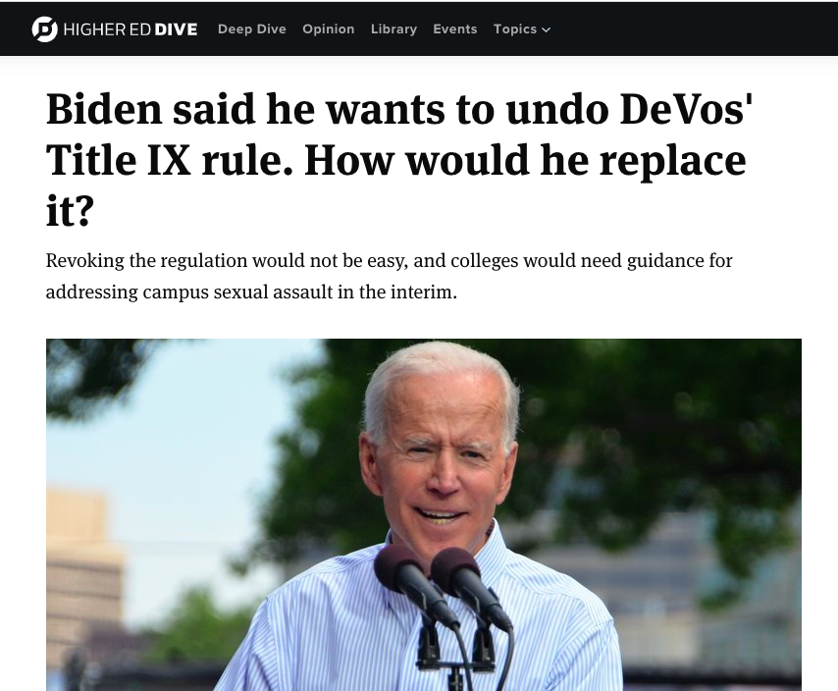

Slide 8
The Long Road to the New Regulations…
September 22, 2017: OCR issued:
Dear Colleague Letter (“2017 DCL”) withdrawing 2011 DCL and 2014 Q&A
Q&A on Campus Sexual Misconduct (“2017 Q&A”)
November 16, 2018: Proposed Regulations Posted
Officially published in Federal Register later in November, 2018
Fact Sheet and Summary also posted
May 6, 2020: Final Regulations Posted
Officially published in Federal Register May 19, 2020
August 14, 2020: Final Regulations Effective

Slide 9
Scope of Institutional Responsibility
Institution must respond when it has:
“Actual knowledge”
When “an official of the recipient who has authority to institute corrective measures” has notice, e.g., Title IX Coordinator
of “sexual harassment” (as newly defined)
that occurred within the school’s “education program or activity”
“includes locations, events, or circumstances over which the recipient exercised substantial control” over the respondent and the context in which the sexual harassment occurred
Fact specific inquiry focused on control, sponsorship, applicable rules, etc.
against a “person in the United States” (so, not in study abroad context)

Slide 10
School’s “education program or activity”
School’s “education program or activity”:
“includes locations, events, or circumstances over which the recipient exercised substantial control” over the respondent and the context in which the sexual harassment occurred.
Not a simple artificial bright-line on/off campus distinction
Does not simply depend on geographic location of activity

Slide 11
School’s “education program or activity”
Examples: Did conduct occur in location/context where school:
Owned premises (or officially recognized student organization that owned or controlled the premises): including fraternities
Exercised oversight, supervision or discipline, or
Funded, sponsored, promoted or endorsed event

Slide 12
School’s “education program or activity”
“[N]othing in the final regulations prevents recipients from initiating a student conduct proceeding or offering supportive measures to students affected by sexual harassment that occurs outside the recipient’s education program or activity.”
Given this change, schools will have to decide whether to prohibit and investigate sexual misconduct that occurs outside more narrowly-defined “education program or activity”
We did!

Slide 13
Title IX Sexual Harassment Prohibited “sexual harassment”
Means conduct on the basis of sex that constitutes one or more of the following:
An employee conditioning the provision of an aid, benefit, or service on an individual’s participation in unwelcome sexual conduct (i.e., quid pro quo);
Unwelcome conduct determined by a reasonable person to be so severe, pervasive, and objectively offensive that it effectively denies a person equal access to an education program or activity (i.e., hostile environment); or

Slide 14
Title IX Sexual Harassment
Prohibited “sexual harassment” means conduct on the basis of sex that constitutes one or more of the following:
Sexual assault (as defined in Clery Act)
FBI/UCR SRS or NIBRS until January 2021, thereafter just NIBRS
Or “dating violence,” “domestic violence,” and “stalking” (as defined in Clery Act/Violence Against Women Act).

Slide 15
Presumption: Respondents Not responsible
Presumption that the respondent is not responsible for the alleged conduct until a determination regarding responsibility is made at the conclusion of the grievance process.
Regulations’ “presumption of non-responsibility” requires schools to investigate and resolve complaints: “without drawing inferences about credibility based on a party’s status as a complainant or respondent.”
Burden of proof and burden of gathering evidence sufficient to reach a determination
regarding responsibility rests on the school and not on the parties!

Slide 16
Procedural Changes
Must investigate “formal complaints”
Must satisfy certain notice and ongoing notice requirements
Must produce investigation report with certain elements
Must give parties and advisors opportunity to review all information “directly related to allegations”
Broader than:
“all relevant evidence” as otherwise used in Title IX regulations, and
“any information that will be used during informal and formal disciplinary meetings and hearings” as used in Clery Act

Slide 17
Procedural Changes
New procedures require that schools:
Ensure that burden of proof and burden of gathering evidence sufficient to reach a determination regarding responsibility rest on the school and not on the parties
Provide equal opportunity for parties to present witnesses and other inculpatory and exculpatory evidence;
Not restrict the ability of either party to discuss the allegations under investigation or to gather and present relevant evidence

Slide 18
Procedural Changes
New procedures require that schools:
Give the parties an equal opportunity to select an advisor of the party’s choice (who may be, but does not need to be, an attorney)
Provide written notice when a party’s participation is invited or expected for an interview, meeting, or hearing;
Provide both parties an equal opportunity to review and respond to the evidence gathered during the investigation; and
Send both parties the investigator’s investigative report summarizing the relevant evidence, prior to reaching a determination regarding responsibility

Slide 19
Informal Resolution possible in all cases.
Informal resolution is permitted in all cases, if a formal complaint is filed. (mediation, training, restorative justice.)
New: It is not permitted for employee-on-student harassment. (EOAA)
All parties must agree to alternative resolution, including the University
Notes:
Kevin, describe the options.
MARJY, HAVE THE OPTIONS CHANGED OR MUST THERE BE INVESTIGATIONS IN ALL CASES?
LASHAWN, DO YOU THINK THIS WILL BE SOMETHING SURVIVORS MAY OPT FOR? HOW COME?

Slide 20
Focus on Conduct, Not Gender

Slide 21
Focus on Conduct, Not Gender
Majority of reported incidents and investigations in university context involve cisgender heterosexual women as complainants and cisgender heterosexual men as respondents, but:
The gender, gender identity and/or sexual orientation of any party to an investigation should have no bearing on how colleges and universities will investigate

Slide 22
Conducting Investigations

Slide 23
Impartiality:
Avoiding Prejudgment,
Conflicts of Interest, and Bias

Slide 24
Impartiality: Avoiding Prejudgment and Bias
From Title IX Regulation Preamble:
“the Department’s interest in ensuring impartial Title IX proceedings that avoid prejudgment of the facts at issue necessitates a broad prohibition on sex stereotypes so that decisions are made on the basis of individualized facts and not on stereotypical notions of what ‘‘men’’ or ‘‘women’’ do or do not do.”

Slide 25
Impartiality: Avoiding Prejudgment and Bias
From Title IX Regulation Preamble:
Contrary to the concerns of some commenters, a prohibition against reliance on sex stereotypes does not forbid training content that references evidence-based information or peer-reviewed scientific research into sexual violence dynamics, including the impact of trauma on sexual assault victims.”
Rather, § 106.45(b)(1)(iii) cautions recipients not to use training materials that ‘‘rely’’ on sex stereotypes in training Title IX personnel on how to serve in those roles impartially and without prejudgment of the facts at issue, meaning that research and data concerning sexual violence dynamics may be valuable and useful, but cannot be relied on to apply generalizations to particular allegations of sexual harassment.”

Slide 26
Impartiality: Avoiding Prejudgment and Bias
Analogous regulatory language:
Regulations’ “presumption of non-responsibility” requires schools to investigate and resolve complaints: “without drawing inferences about credibility based on a party’s status as a complainant or respondent.”
Investigators, Decision-makers, Title IX Coordinators must not have “bias for or against complainants or respondents generally or for an individual complainant or respondent”

Slide 27
Impartiality: Avoiding Prejudgment and Bias
Preamble repeatedly warns against risk of “sex-based bias” in decision-making
Preamble:
“To the extent that commenters accurately describe negative stereotypes applied against students with disabilities, and particularly against students with disabilities who are also students of color or LGBTQ students, the final regulations expressly require recipients to interact with every complainant and every respondent impartially and without bias.”
“A recipient that ignores, blames, or punishes a student due to stereotypes about the student violates the final regulations.”

Slide 28
Impartiality: Avoiding Prejudgment and Bias
Practical application of these concepts in investigations:
Do not rely on cultural “rape myths” that essentially blame complainants
Do not rely on cultural stereotypes about how men or women purportedly behave
Do not rely on gender-specific research data or theories to decide or make inferences of relevance or credibility in particular cases

Slide 29
Impartiality: Avoiding Prejudgment and Bias
Practical application of these concepts in investigations:
Recognize that anyone, regardless of sex, gender, gender identity or sexual orientation, can be a victim or perpetrator of sexual assault or other violence
Avoid any perception of bias in favor of or against complainants or respondents generally
Employ interview and investigation approaches that demonstrate a commitment to impartiality

Slide 30
Impartiality: Avoiding Prejudgment, Bias, and Conflicts of Interest
Bottom line:
Follow facts of every individual case
Investigate in manner that will not allow even a perception of prejudgment or bias for or against any party

Slide 31
“Directly Related” and “Relevance” Concepts

Slide 32
“Directly Related” Evidence
Regulation:
Parties must have equal opportunity to inspect and review evidence obtained as part of the investigation that is directly related to the allegations raised in a formal complaint
Including evidence upon which the school does not intend to rely in reaching a determination regarding responsibility and inculpatory or exculpatory evidence whether obtained from a party or other source
So that each party can meaningfully respond to the evidence prior to the conclusion of the investigation

Slide 33
“Directly Related” Evidence
In Preamble, Department declines to define “directly related” further, indicating that it “should be interpreted using [its] plain and ordinary meaning.”
Department notes that term aligns with (similarly undefined) term in Family Educational Rights and Privacy Act (“FERPA”), which defines covered education records in part as documents that are:
“directly related to a student; and
Maintained by an educational agency or institution . . . .”
Department ties parties’ right to review directly related information under Title IX regulations with Department’s prior position that students may review FERPA-protected information about other students if necessary to preserve their due process rights

Slide 34
“Directly Related” Evidence
Term is broader than:
“all relevant evidence” as otherwise used in Title IX regulations, and
“any information that will be used during informal and formal disciplinary meetings and hearings” as used in Clery Act
Point of information-sharing provision is to promote transparency and allow parties to object to investigator’s conclusion that certain evidence is not relevant, and argue why certain evidence should be given more weight
Cautious approach:
Read term broadly, withholding or redacting information only where explicitly irrelevant under regulations (see below), or where not related to allegations

Slide 35
“Relevant” Evidence
Investigative reports must “summarize relevant evidence”
The Department declines to define “relevant”, indicating that term “should be interpreted using [its] plain and ordinary meaning.”
See, e.g., Federal Rule of Evidence 401 Test for Relevant Evidence:
“Evidence is relevant if:
(a) it has any tendency to make a fact more or less probable than it would be without the evidence; and
(b) the fact is of consequence in determining the action.”

Slide 36
“Relevant” Evidence
Department emphasizes repeatedly in Preamble that investigators have discretion to determine relevance
Subject to parties’ right to argue upon review of “directly related” evidence that certain information not included in investigative report is relevant and should be given more weight
Investigators will have to balance discretionary decisions not to summarize certain evidence in report against:
Each party’s right to argue their case, and
Fact that decisions regarding responsibility will be made at hearing, not investigation stage

Slide 37
Evidence That is Not “Relevant”
Hearing-related regulation provides:
“Questions and evidence about the complainant’s sexual predisposition or prior sexual behavior are not relevant,
unless such questions and evidence about the complainant’s prior sexual behavior are offered to prove that someone other than the respondent committed the conduct alleged by the complainant, or
if the questions and evidence concern specific incidents of the complainant’s prior sexual behavior with respect to the respondent and are offered to prove consent.”

Slide 38
Evidence That is Not “Relevant”
Regulations provide that schools will not:
“require, allow, rely upon, or otherwise use questions or evidence that constitute, or seek disclosure of, information protected under a legally recognized privilege, unless the person holding such privilege has waived the privilege.”
Physical and mental health records and attorney-client privileged communications would fit within scope of this prohibition

Slide 39
Creating Investigative Reports

Slide 40
What category of evidence do we put into the report?
What do parties get to see in the evidence review?
As per the Policy, evidence that will be made available for inspection review will be any evidence that is directly related to the allegations raised in the Title IX formal complaint. This includes evidence that is both:
(1) relevant
(2) directly related
Evidence considered irrelevant and not directly related to the allegations by the Investigative Team is not provided to the Parties or included in the Investigative Report.
See Policy pgs. 66-67.

Slide 41
Evidence Review Timeline The Parties are Provided:
Ten (10) business days to inspect and review the evidence and submit a written response
Five (5) additional business days to submit additional evidence
Five (5) additional business days to inspect and review the additional evidence and submit a written response to any additional evidence

Slide 42
How do we organize this for evidence review?

Slide 43
Summarizing “Relevant” Evidence
Again, Department emphasizes repeatedly in Preamble that investigators have discretion to determine relevance
Subject to parties’ right to argue upon review of “directly related” evidence that certain information not included in investigative report is relevant and should be given more weight
Investigators will have to balance discretionary decisions not to summarize certain evidence in report against:
Each party’s right to argue their case, and
Fact that decisions regarding responsibility will be made at hearing, not investigation stage

Slide 44
Investigative Reports
Regulation:
“Prior to completion of the investigative report, the [school] must send to each party and the party’s advisor, if any, the evidence subject to inspection and review in an electronic format or a hard copy, and
the parties must have at least 10 days to submit a written response, which the investigator will consider prior to completion of the investigative report.”

Slide 45
Investigative Reports
Regulation:
Investigative reports must “fairly summarize relevant evidence”
“at least 10 days prior to a hearing . . . send to each party and the party’s advisor, if any, the
investigative report in an electronic format or a hard copy, for their review and written response.”
Investigator does not need to revise investigative report in light of this written response from parties
Can attach as exhibit

Slide 46
Recommendations Regarding Responsibility?
In addition to summarizing relevant evidence, investigative reports MAY include a recommendation regarding responsibility and related analysis
We do!
Recommendation option is not specifically required or prohibited by regulations or Preamble
Regs: Whether to include recommendations or not may be decided by each institution at its discretion
Obviously, decision-makers must make independent decisions based on
Investigative report and related evidence, and
Information presented at hearing, including information resulting from cross-examination

Slide 47
Introduction to Witness-Centered Interview Concepts

Slide 48
Traditional Interview Techniques
Often focus on “who, what, when, where, why”
Often focus on what questioner thinks they need, e.g.:
Developing a chronology
Fitting facts into policy violation elements framework
Questioner’s determinations and (worse yet) pre-determinations of what is relevant, and what is not, can be controlling
Questioner often interrupts witness to seek immediate clarification
Common questioning techniques:
Leading questions
Yes/no or choice questions
Paraphrasing for “clarification”
“Why did you/why didn’t you” questions that can discourage participation

Slide 49
“Malleability of Memory”
Elizabeth Loftus, Ph.D., “Planting misinformation in the human mind: A 30-year investigation of the malleability of memory,” Learning & Memory (2005) (reviews 30 years of research)
Summarizes research on “misinformation effect”, whereby study subjects report that they “remember” observing details in scenarios that were not actually there, because researchers intentionally misinformed them that those details were there
Subjects found to be more susceptible to effect where:
Relatively more time had passed between observation and test
Subject self-reported they often had lapses in memory and attention
Article notes that in the “real world”, “misinformation” that contaminates memory can come from:
Witnesses’ talking to each other
Leading questions or suggestive techniques
Media coverage

Slide 50
“Creating False Memories”
Elizabeth Loftus, Ph.D., “Creating False Memories,” Scientific American (Vol. 277 #3, pp. 70-75)
Loftus and others did “lost in the mall” experiments in which adult study subjects were asked to “try to remember” events that subjects were told a family member had told the researchers about
Subjects were given three one-paragraph descriptions of events that had actually happened to the subjects in childhood, as reported by relatives, and one description of a “lost in the mall” event that had not actually happened

Slide 51
“Creating False Memories”
Elizabeth Loftus, Ph.D., “Creating False Memories,” Scientific American (Vol. 277 #3, pp. 70-75)
29 percent “remembered”, either partially or fully, the false event
Takeaways per researchers:
“Memories are more easily modified . . . when the passage of time allows the original memory to fade.”
“Corroboration of an event by another person can be a powerful technique for instilling a false memory.”
Potential application to interview/investigation context:
Questioners should take care to avoid questioning approaches that could undermine a witness’s recollection of authentic memories
Leading, yes/no choice, and paraphrasing questions can potentially have such an effect

Slide 52
“The Cognitive Interview” (1992)
“Mechanics of Interviewing” (Chapter 6)
Not all aspects of law enforcement-focused discussion and examples would translate well to neutral, Title IX/Clery investigative context, but some noteworthy general concepts include:
Use neutral questions rather than leading questions
Avoid negative wording (e.g., “You don’t know X, do you?)
Avoid compound questions
Avoid unnecessarily complex questions
Avoid jargon and technical terminology
Generally use open-ended rather than closed questions, and only used closed questions strategically, once basic answers to closed questions were established through responses to open-ended questions
Pace questioning slowly and allow pauses between questions to encourage witnesses to speak more freely
Inquiring about touch, smell and taste sensory impressions

Slide 65
Interviewing for Clarification
Interviewing/Questioning for Clarification
It is crucial to interview and question witnesses for clarification (sometimes in initial, and definitely in follow up, interviews)
Promotes accuracy and fairness
If done appropriately, should not alienate witnesses
Examples of how to present evidence, statements of other witnesses to parties

Slide 66
Fair, Witness-Centered Approach
Investigators should seek clarification on crucial points, but starting with a more open-ended, witness-centered approach can:
Yield more, and more accurate, information
Better encourage witness participation
Be less likely to interfere with authentic memory

Slide 67
Fair, Witness-Centered Approach
Even witnesses who do not appear to have experienced trauma (e.g., many respondents), may be experiencing substantial stress due to investigation and interview setting
Same open-ended questioning approach is just as effective when used with respondents
And should be used if used with complainants, to promote neutrality
As with complainants, should not rely unduly on “presentation as evidence”

Slide 68
Fair, Witness-Centered Approach
Like complainants, respondents can be provided opportunity for open-ended narrative
Similar cues can be used
Sensory information can be gathered from respondents
Avoiding leading questions, yes/no questions, paraphrasing, etc. is important for respondent questioning as well
Goal: Neutral, open-ended questioning approach should be used with both parties

Slide 69
Title IX Hearings….summary but for another day…
Must be live, but can be conducted remotely
No Compelling participation
Standard of proof used may be preponderance of the evidence or clear and convincing; standard must be the same for student and employee matters
Cross examination must be permitted and must be conducted by advisor of choice or provided by the institution
Decision maker determines relevancy of questions and evidence offered
Written decision must be issued that includes finding and sanction

Slide 70
Decision-maker Role
Evaluating the Evidence
What weight, if any, should it be given? | Weight is determined by the finder of fact!
Is it reliable? | Can you trust it or really on it?
Is it credible? | Is it convincing?
Is it authentic? | Is the item what it purports to be?
Is it relevant? | Evidence is relevant if it tends to make a material fact more or less likely to be true.

Slide 71
HEARING PARTICIPANTS
Hearing Participants
Complainant | The person bringing the complaint
Respondent | The person whom the complaint has been filed
Advisor | Will conduct cross examination; role varies depending on school
Investigator | Summarizes the investigation, answers questions
Witnesses | Present in the room only when answering questions
Hearing Coordinator/Officer | Coordinates all aspects of the hearing, ensures a fair and equitable hearing process, acts as a resource for all participants
Decision-Maker | Makes decision as to whether policy was violated, can be one person or a panel
Administrative Staff | Assists with the logistical coordination of the people, the space, technology, etc.

