Slide 1
CSSI and Title IX at Columbia University: Title IX and Gender-Based Misconduct
Marjory Fisher. JD
Title IX Coordinator
Columbia University
Notes:
Introduction: each presenter introduce self, SCCS and EOAA and what each does.
This is the point where we normally give the sensitivity trigger warning.
What I am going to do today is:
Fly through a brief overview of our policy and what we normally tell students and other staff. I’m not going to get too wrapped up in definitions of sexual assault.
What I want to do is take you through a bit of what happens when we get a report. We are going to stress the case management function, but we will talk a bit about the actual investigation without getting into the weeds.
c. Discuss discrimination and harassment at Columbia and EOAA’s Role

Slide 2
Marjory Fisher
Title IX Coordinator, Columbia University since June 2016
Consultant to colleges and universities on the issues of sexual assault and domestic violence from 2013-2016
Served as Bureau Chief of the Queens District Attorney’s Office Special Victims Bureau for over 23 years
Investigated and supervised thousands of sexual assault, abuse and harassment cases and trained and educated innumerable attorneys, law enforcement officers, students, parents, faculty, health care professionals and the public at large
Published The Prosecutor’s Manual for Sex Crimes, a how-to guide for investigating and prosecuting sexual assaults
Served on the New York State Children’s Justice Task Force, the New York City Mayor’s Committee on Child Abuse and the Mayor’s Sex Crimes Task Force
Adjunct Professor of Law at St. John’s University Law School
Graduate of Indiana University and George Washington University’s National Law Center
Marjory Fisher
Associate Vice President &
Title IX Coordinator
Direct 212-853-1276
m.fisher@columbia.edu
Notes:
Speaker should insert own bio, and give warnings that some material covered in this presentation could be upsetting…so feel free to leave if you need to.

Slide 3
What do I hope to share with you today?
Brief Review of Gender-Based Misconduct Policy for Students
Resources and Reporting
Student Conduct and Community Standards
Equal Opportunity and Affirmative Action
Other relevant partner offices and other identified resources
Reporting Procedure
Changes in Title IX regulations affecting our Gender-Based Misconduct Policy
What do Columbia students learn about this topic upon arrival?
Why is this important for YOU to know?
Not the black hole that it is perceived to be!
Notes:
A very brief overview of our policy.
Mostly I want to talk about what happens when we receive a report

Slide 4
Where our worlds intersect… We both may see and hear from parties in a gender-based misconduct case when the cases intersect.

Slide 5
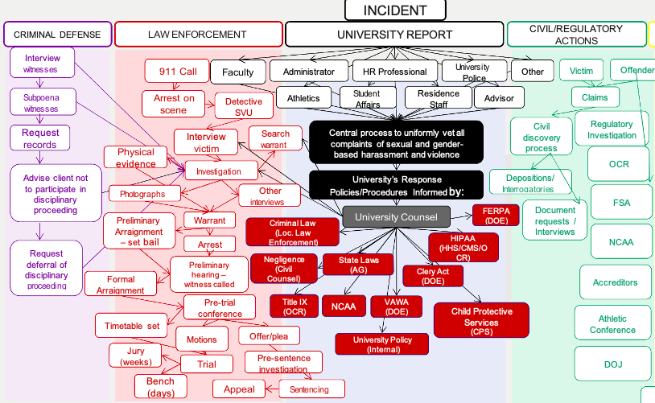
A roadmap?

Slide 6
The law and our policy: The Response to Sexual Assault, Sexual Harassment and Dating Violence on Campus

Slide 7
Anyone know what Title IX is? A brief history lesson…
Notes:
Most will say gender equity in sports…which is still true. But now T9 has been re-interpreted to define discrimination as the creation of a hostile educational environment, when there is sexual violence, sexual harassment or dating or dv, or stalking…if any of these conditions exist, the University is tasked with eliminating it.

Slide 8
Title IX. . .The Beginning
Notes:
Sports Illustrated cover from early 1970s…T9 then compared to T9 now

Slide 9
Title IX and the Women’s World Cup in Soccer
Between the year Title IX was passed (1972) and the first Women’s World Cup (1991), the sport saw a 17,000% increase in U.S. girls playing on high school soccer teams, according to the National Federation of High School Assns.
Notes:
Consent is the backbone of our policy. This is our policy definition of consent, consistent with NYS law.
Columbia implemented an affirmative consent requirement before this recent legislation, it has simply now been codified for all institutions of higher education that receive state funds and directly incorporated (word-for-word) into our Policy.
Something similar to this on all campuses in the United States, due to guidance under T9

Slide 10
Title IX. . .Then
Title IX requires that university policies prohibit certain behaviors and requires that colleges and universities do their best to ensure a “harassment-free environment.”
“When a school knows or reasonably should know of possible sexual violence, it must take immediate and appropriate steps to investigate or otherwise determine what occurred. Investigations must be prompt, thorough, fair, impartial and equitable.
If the investigation reveals…a hostile environment, the school must then take prompt and effective steps reasonably calculated to end the sexual violence, eliminate the hostile environment, prevent its recurrence, and, as appropriate, remedy its effects.
Withdrawn, as of September, 2017…changes have arrived.

Slide 11
No More…SVU

Slide 12
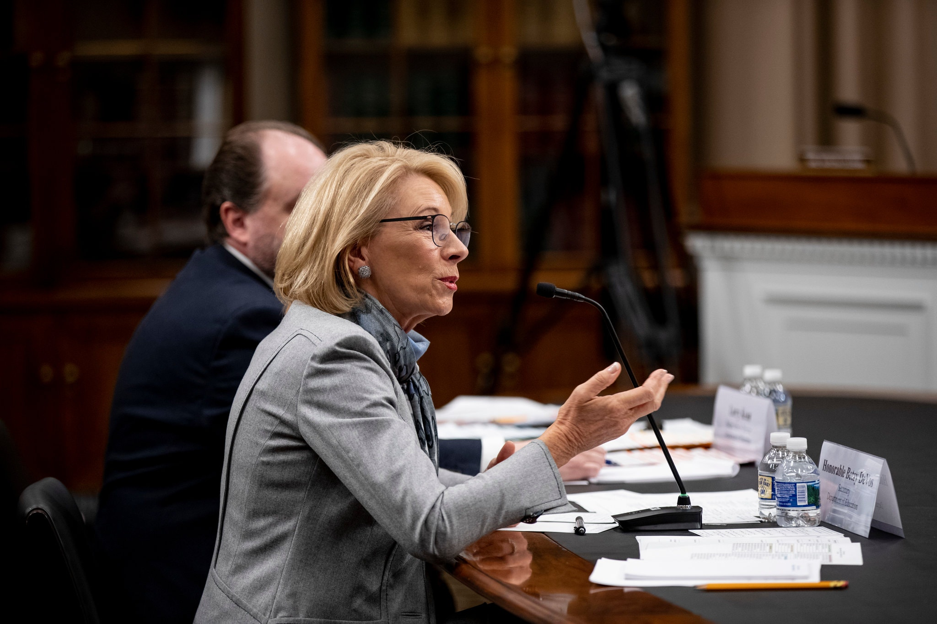
What’s Next? She’s GONE, But her rules are still here!!

Slide 13
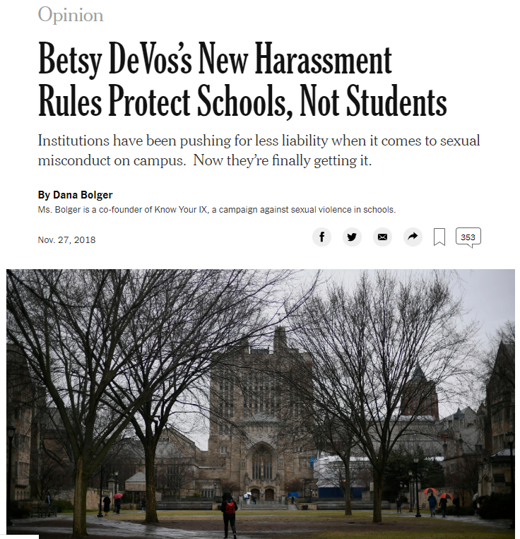
What’s next?

Slide 14
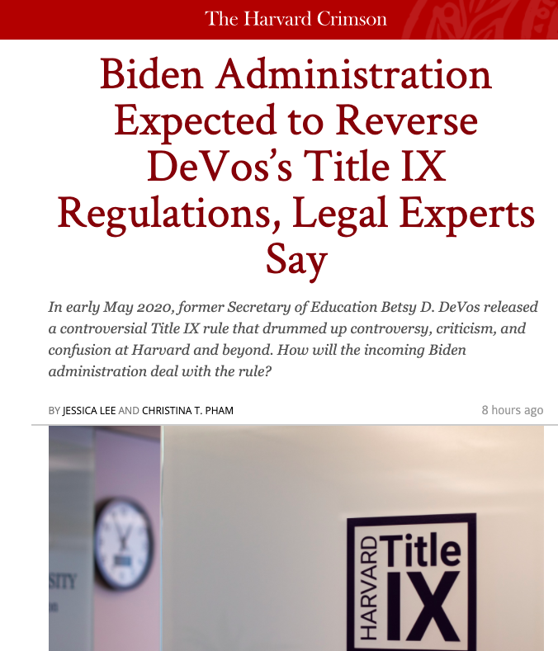
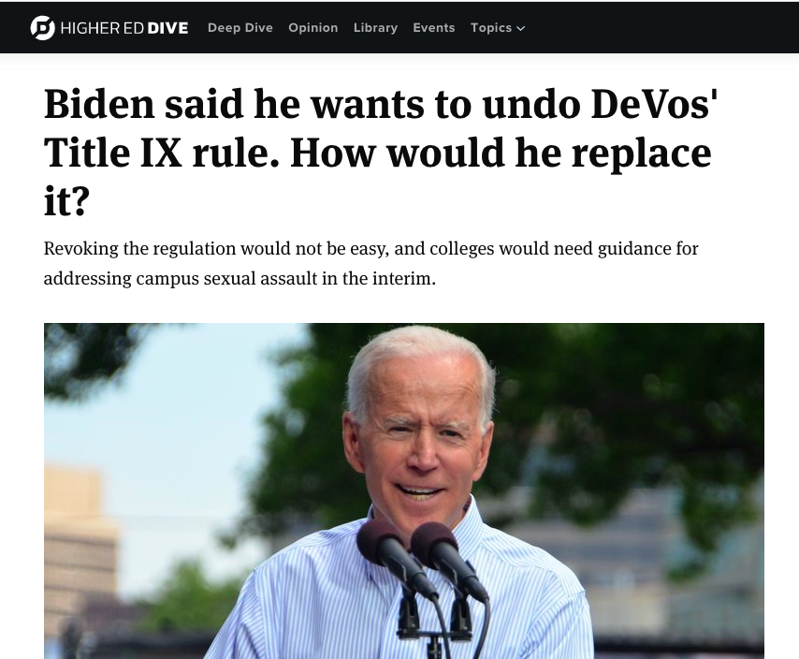

Slide 15
Title IX Now : Two University Policies
On May 19, 2020, the U.S. Department of Education issued an updated set of regulations under Title IX that more narrowly defines sexual harassment and addresses how institutions must respond to reports within that definition. These regulations do not cover all of the types of misconduct or places in which misconduct occurs that Columbia believes must be addressed in keeping with our own non-discrimination commitment and our obligations under state and local law. For this reason, the University now has two policies: the Interim Title IX Policy and the Gender-Based Misconduct Policy.
Off-Campus Gender-Based Misconduct may continue to constitute a violation of University policy.
Supportive Measures, including no contact directives, housing changes, and other accommodations, will continue to be available with or without an investigation or adjudication.
Resolutions that are not punitive or disciplinary in nature will continue to be available options.
Students who are parties in any gender-based investigation or adjudication will have access to attorneys to serve as advisors.
Questioning during an investigation and adjudication will take the form of live cross examination under the Interim Title IX Policy and continue to occur in writing, through an Investigative Team under the Gender-Based Misconduct Policy.
Live hearings, including the use of remote technology, will continue to be provided for the adjudication of gender-based misconduct.

Slide 16
And, New York’s Enough is Enough Defines prohibited behavior on all campuses in New York State.
x

Slide 17
Scope of the policy
The policy applies to all types of relationships:
Casual, Long-term, Marriages
Umbrella term used to describe a broad range of behaviors:
Sexual Harassment
Gender-Based Harassment
Dating Violence
Domestic Violence
Stalking
Sexual Exploitation
Sexual Assault: Penetration
Sexual Assault: Contact
Notes:
“Gender-Based Misconduct” – it may sound a bit more vague than “Sexual Violence Response” ……what exactly does that mean? The term “gender-based misconduct” is an umbrella term, and in the next slide we’re going to review the various definitions so that you have a sense of the type of behaviors we’re investigating in our office.
The Policy applies to all student affiliates of Columbia University, whether they are studying here on the Morningside Heights Campus, or they’re studying abroad in China. As long as you’re an affiliated student of this University, you are covered under this Policy.
Gender-based misconduct can occur among individuals regardless of their relationship status/duration, their gender identity, or their particular racial or other protected identifying class.

Slide 18
How exactly is Sexual Assault defined under Columbia’s Policy?

Slide 19
Policy Definitions of Gender-Based Misconduct
Sexual Assault: Penetration Any form of sexual intercourse without affirmative consent.
Intercourse is: vaginal penetration (however slight) by a penis, object, tongue, or finger; anal penetration by a penis, object, tongue or finger; and oral copulation (mouth to genital contact or genital to mouth contact)
Sexual Assault: Contact Any intentional sexual touching for the purpose of sexual gratification without affirmative consent.
Sexual touching includes contact under or over clothing with the breasts, buttocks, genitals, groin, or touching another with any of these body parts, or making another person touch any of these body parts
Notes:
You may want to stress the difference in sexual intercourse definition from what they may know or understand – Columbia’s Policy definition is more expansive and broad than other legal definitions you may be familiar with.

Slide 20
Affirmative Consent: The Bedrock of Columbia’s Policy
Our policy (and New York State Legislation) states:
“Affirmative consent is a knowing, voluntary, and mutual decision among all participants to engage in sexual activity. Consent can be given by words or actions, as long as those words or actions create clear permission regarding willingness to engage in the sexual activity. Silence or lack of resistance, in and of itself, does not demonstrate consent. The definition of consent does not vary based upon a participant's sex, sexual orientation, gender identity, or gender expression.”
Notes:
Consent is the backbone of our policy. This is our policy definition of consent, consistent with NYS law.
Columbia implemented an affirmative consent requirement before this recent legislation, it has simply now been codified for all institutions of higher education that receive state funds and directly incorporated (word-for-word) into our Policy.
Marjy will talk about this more in next presentation

Slide 21
Affirmative Consent: Alcohol and other Drugs
Can you consent if you are intoxicated?
Notes:
CLICK FOR TEXT TO APPEAR
Ask for definition from group: difference between intoxication, incapacitation, and black out. It is a spectrum.
“Out cold” on the one end and “totally fine” on the other
Where is the line between the two?
How about on verge of losing consciousness?
How about enough drinks to be a little “high”?
When does impaired judgment become incapacitation?
Is it when you are “legally” intoxicated, i.e., over .08 BAC?
Intoxication is not the same thing as incapacitation

Slide 22
What Does It Mean to be Incapacitated?
When someone cannot make rational, reasonable decisions because they lack the capacity to give knowing consent (e.g., to understand the “who, what, when, where, why or how” of the sexual interaction)
If you are “incapacitated” you may NOT be able to understand that you can decide NOT to consent to sex.
Incapacity can result from a person’s consumption of alcohol and/or other drugs, disability, being physically constrained, or sleep.
If I have had a few drinks, can I still consent?
It’s a continuum! You can be intoxicated, and tipsy, and still able to consent, or incapacitated and almost unconscious, and unable to consent.
Notes:
Ask for definition from group: difference between intoxication, incapacitation, and black out. It is a spectrum.
“Out cold” on the one end and “totally fine” on the other
Where is the line between the two?
How about on verge of losing consciousness?
How about enough drinks to be a little “high”?
When does impaired judgment become incapacitation?
Is it when you are “legally” intoxicated, i.e., over .08 BAC?
Intoxication is not the same thing as incapacitation

Slide 23
Affirmative Consent: Alcohol and other Drugs
If I have had a few drinks, can I still consent? Can my partner consent?
Remember: if you, or your partner have not affirmatively consented to a sexual interaction, that is sexual assault under Columbia’s Affirmative Consent policy (and NY State Law)
Notes:
CLICK FOR TEXT TO APPEAR
Ask for definition from group: difference between intoxication, incapacitation, and black out. It is a spectrum.
“Out cold” on the one end and “totally fine” on the other
Where is the line between the two?
How about on verge of losing consciousness?
How about enough drinks to be a little “high”?
When does impaired judgment become incapacitation?
Is it when you are “legally” intoxicated, i.e., over .08 BAC?
Intoxication is not the same thing as incapacitation

Slide 24
What we tell students when they arrive here: Guidelines for Affirmative Consent
You can’t get it by the use of physical force, compulsion, threats, intimidating behavior, “coercion,” or from a person who is “incapacitated.”
Consent to one form of sexual activity does not mean consent to other forms of sexual activity.
Consent to engage in sexual activity with one person does not mean they consent to engage in sexual activity with another person.
Silence or the lack of resistance, in and of itself, does not demonstrate consent.
Don’t make is make assumptions; if confusion arises during a sexual interaction, it is essential that all participants stop and verbally clarify the other’s willingness to continue engaging in the sexual contact or activity.
Consent may be initially given, but can be withdrawn at any time. When consent is withdrawn or can no longer be given, sexual activity must stop.
Previous relationships or previous consent for sexual activity is not consent to sexual activity on a different occasion.
The definition of consent does not vary based upon a participant’s sex, sexual orientation, gender identity, gender expression or relationship status.

Slide 25
What does this really mean?
Consent then does not mean consent now! Consent to any sexual act or prior consensual sexual activity between or with any party does not necessarily constitute consent to any other sexual act.
Our relationship does not mean I consent to sex! The existence of a prior or current relationship does not, in itself, constitute consent.
You must get consent even if I am drunk. Consent is required regardless of whether the person initiating the act is under the influence of drugs and/or alcohol.
I can withdraw my consent whenever I want. Consent may be initially given but withdrawn or modified at any time.
What I am wearing doesn’t mean I consent.
If you buy me dinner, it doesn’t mean I will consent! A meal, a gift, or an invitation for a date does not imply or constitute consent.

Slide 26
Dating Violence. Domestic Violence. Stalking. Sexual Exploitation.
Domestic Violence
The use of physical violence, coercion, threats, isolation, stalking, or other forms of emotional, psychological, sexual, technological, or economic abuse directed toward (1) a current or former spouse or intimate partner; (2) a person with whom one shares a child; or (3) anyone who is protected from the Respondent’s acts under the domestic or family violence laws of New York. This violation includes behavior that seeks to establish power and control over another person by causing fear of physical or sexual violence. Domestic violence can be a single act or a pattern of behavior, depending on the frequency, nature, and severity of the conduct.
Examples of this type of violence include hitting, kicking, punching, strangling, or other violent acts, including violence or threats of violence to oneself under certain circumstances, violence or threats of violence to one’s partner, or the family members, friends, pets, or personal property of the partner.
Dating Violence
The use of physical violence, coercion, threats, isolation, stalking, or other forms of serious emotional, psychological, sexual, technological, or economic abuse directed toward a person who is or has been in a social relationship of a romantic or sexually intimate nature with the victim. Dating violence can be a single act or a pattern of behavior in relationships.

Slide 27
Sexual Exploitation Non-consensual abuse or exploitation of another person’s sexuality for the purpose of sexual gratification, financial gain, personal benefit or advantage, or any other illicit purpose.
Stalking
A course of unwanted attention that is repeated or obsessive, directed toward an individual or a group and that is reasonably likely to cause alarm, fear or substantial emotional distress. Stalking may take many forms, including lying in wait for, monitoring, and/or pursuing contact. Stalking may occur in person or through communications such as telephone calls, text messages, unwanted gifts, letters, e-mails, surveillance, or other types of observation.

Slide 28
Yeardley Love, UVA
Lauren McCluskey, University of Utah
Y
L

Slide 29
How did the DeVos rules change this Process?
Limits on which cases universities MUST address

Slide 30
What to do if the case doesn’t fit under Title IX Policy Definitions?
The Gender Based Misconduct Policy covers everything else.
On May 19, 2020, the U.S. Department of Education issued an updated set of regulations under Title IX that:
Defines “sexual harassment” to include certain forms of sexual assault and other gender-based misconduct. This definition limits Title IX’s coverage to cases involving misconduct that is “severe, pervasive and objectively offensive”
Addresses how higher education institutions that receive federal funding (including Columbia University) must respond to reports of misconduct falling within that definition of sexual harassment, and
Sets out a detailed grievance process that higher education institutions (including Columbia University) must follow when investigating, adjudicating and imposing sanctions in cases involving sexual harassment under that definition.
These new regulations cover some occurrences of sexual assault and other gender-based misconduct. They do not cover all of the types of misconduct or places in which misconduct occurs that Columbia believes must be addressed in keeping with our own non-discrimination commitment and our obligations under state and local law.
For this reason, the University now has two policies: the Interim Title IX Policy that addresses cases covered by the new regulations, and the Gender-Based Misconduct Policy that addresses gender-based misconduct not covered by the new regulations. Both are included in one document.

Slide 31
What is an educational program or activity?
The definitions of “program or activity” state that our Title IX obligations extend to sexual harassment incidents that occur off campus only if any of three conditions are met:
– if the off-campus incident occurs as part of our ‘operations’ – if we exercised substantial control over the respondent and the context of alleged sexual harassment that occurred off campus
– if a sexual harassment incident occurs at an off-campus building owned or controlled by a student organization
At the time of filing a formal complaint, a complainant must be a participant or attempting to participate in the education program or activity of the University.
The following may constitute “attempting to participate” in the recipient’s education program or activity:
Applying (or intending to apply) for admission
Indicating a desire to re-enroll if the recipient appropriately responds to sexual harassment allegations
Intending to remain involved in alumni programs

Slide 32
Participation in a Hearing is required IN SOME Cases that fit the current definition of Title IX.
New regulations provide for a live hearing in cases falling under the definition of Title IX.
Permit each party’s advisor to ask the other party and any witnesses all relevant questions
Advisors — not parties — must perform cross-examination.
Witnesses will testify
Advisors must be provided without fee or charge to conduct cross-examination at the hearing
We provide attorneys to all parties at no cost.
Decision-makers must make and articulate relevance decisions, including with respect to prior sexual history.

Slide 33
What does “cross-examination” mean?
Cross-Examination required: During a hearing to resolve an allegation of misconduct under the Interim Title IX Policy, each Party’s advisor is permitted to ask the other Party and any witnesses relevant questions, including those challenging an individual’s credibility or reliability.
This questioning will be monitored by the Hearing Chair and is restricted by rules regarding relevance and decorum.
Such questioning must be conducted directly, orally, and in real time by the Party’s advisor and never by a Party personally.
Likely to concern some students who are worried about submitting to such process.

Slide 34
What remains the same?
Mandatory Reporting
Off campus conduct still covered
Study Abroad conduct still covered
Supportive Measures still offered, whether or not you file a complaint, provided to both parties
Preponderance of the evidence standard still applies
Right of Appeal still available to both parties
Informal resolutions offered in lieu of investigations in all types of cases, provided the University believes such option is appropriate and the parties agree.
Attorney-advisors provided free of charge for parties in Interim Title IX cases and for those handled under the Gender based Misconduct policy

Slide 35
Important Policy Provisions
Different Obligations for CSSI and Title IX
Supportive Measures
Interim Suspension vs. Emergency Removal

Slide 36
Supportive Accommodations
The Title IX Coordinator and the Office work with all students to promote their safety and promote their well-being throughout their time at the University, including by helping to secure appropriate supportive accommodations.
Students may request supportive accommodations even in cases where an investigation is not undertaken or either Party has declined to participate in the University disciplinary process.
The Title IX Coordinator and the Office evaluate requests for supportive accommodations in light of the circumstances and information available at the time of the request. In some instances, additional information may be required to sufficiently evaluate the need or provide for a requested supportive accommodation. If requested accommodations cannot be granted, the Office will provide an explanation, in writing, to the student.

Slide 37
Supportive accommodations may include, but are not limited to:
Relocation of a student’s residence (at no cost);
Adjusting a student’s work schedule for University employment;
Changing a student’s academic schedule;
Allowing a student to withdraw from or retake a class without penalty; and/or
Providing access to tutoring or other academic support.
In consultation with the appropriate Title IX Coordinator(s), the Office will work with students to obtain additional supportive accommodations as necessary.

Slide 38
Interim Measures
The University may also impose interim measures, based on the totality of facts known at the time, to protect the safety of all Parties involved, to prevent the escalation of conflict, and to protect the integrity of the disciplinary /process while the process is ongoing. Interim measures include, but are not limited to:ervices/accordion- 1/general-registration-
No-contact directives;
Restricting a Party’s access to campus buildings and/or University property;
Moving a student’s residence
Indicating on a student’s official transcript that a disciplinary investigation is pending; or
Withholding a student’s transcript, diploma and/or degree, as indicated by an administrative hold.

Slide 39
What about removing respondents from campus during an investigation?
Or from residence halls?
From a team?
From a club?

Slide 40
Emergency Removal
Title IX Regulations § 106.44(c)

Slide 41
What did DeVos do about teams, clubs and orgs removing members before there is a University finding of responsibility?

Slide 42
Emergency Removal § 106.44(c)
Respondent may be removed from a club, team or off-campus entirely on an emergency basis (prior to adjudication/completion of the grievance process) “provided that the [University's] undertakes an individualized safety and risk analysis, determines that an immediate threat to the physical health or safety of any student or other individual arising from the allegations of sexual harassment justifies removal, and provides the respondent with notice and an opportunity to challenge the decision immediately following removal.”
Cannot remove someone any longer where threat is that a complainant will suffer emotional harm.

Slide 43
Emergency Removal: How do we determine immediate risk?
Nothing precludes a University from removing a respondent from the recipient’s education program or activity on an emergency basis, provided that the recipient undertakes an individualized safety and risk analysis, determines that an immediate threat to the physical health or safety of any student or other individual arising from the allegations of sexual harassment justifies removal, and provides the respondent with notice and an opportunity to challenge the decision immediately following the removal.

Slide 44
The preamble to the final rule elaborates that this analysis must consider the particular respondent and examine the circumstances specific to the situation.
These circumstances can include “factors such as whether violence was allegedly involved in the conduct constituting sexual harassment, but could also include circumstances that ‘arise from’ the allegations yet do not constitute the alleged conduct itself; for example, a respondent could pose an immediate threat of physical self-harm in reaction to being accused of sexual harassment…
Ultimately, to make an emergency removal, the preamble explains, this individualized safety and risk assessment must yield “more than a generalized, hypothetical, or speculative belief that the respondent may pose a risk to someone’s physical health or safety.” Id.
The Department stated its belief “that further describing what might constitute an emergency would undermine the purpose of this provision, which is to set a high threshold for emergency removal yet ensure that the provision will apply to the variety of circumstances that could present such an emergency.”

Slide 45
When is an emergency removal allowed?
When there is an emergency situation that constitutes an immediate threat to the physical health or safety of any student or individual, and that threat arises from alleged conduct that could constitute sexual harassment as defined by the Regs.
No temporal restriction because risks arising from sexual harassment can occur at any time.
Identification of immediate risk is not limited to the details of the alleged sexual harassment itself — can also be related to the respondent’s post-incident actions or behaviors.
If a respondent’s actions pose an immediate and identified threat, but do not “arise from” allegations of sexual harassment as defined by the Regs (i.e. if they bring a weapon to school but unrelated to any sexual harassment allegations), § 106.44(c) does not apply and the university can respond under its regular code of conduct or applicable laws.

Slide 46
Whereas changing a respondent’s class schedule, housing, or dining hall assignment may constitute a permissible “supportive measure” depending on the circumstances, removing a respondent from the entirety of an institution’s education programs and activities — or even just one or more (such as removal from a team, club, or extracurricular activity) — would likely constitute an unreasonable burden on the respondent or be deemed disciplinary or punitive, and therefore wouldn’t qualify as a supportive measure.
Until and unless the grievance process has been completed, removals of the respondent from an institution’s education program or activity need to meet the standards for emergency removals under § 106.44(c).

Slide 47
Reality?
Proving an immediate threat to the physical health or safety of any student or other individual arising from the allegations of sexual harassment is likely almost impossible.
So most people accused of a sexual assault will likely remain on campus while investigation is happening.

Slide 48
The Duty to Report
What You Need to Know

Slide 49
Columbia’s Policy: Reporting Misconduct when Students are Involved
When prohibited conduct involves students, there are additional reporting obligations.
The following employees have a duty to report any instance or allegation of prohibited conduct involving a student that is disclosed to, observed, or otherwise known by them whether the student is a Complainant or a Respondent:
Staff who work directly with students, including: teaching assistants, advising and residential program staff (including residence assistants and student affairs staff).
Faculty, Officers of Administration, Research, the Libraries and the Coaching Staff.

Slide 50
Who are Responsible Employees?
Academic Advisors
Student Affairs staff
Resident Advisors
Peer Leaders
Orientation Leaders
Admissions Staff
Deans
Officers of the institution
Faculty and TAs

Slide 51
What must be reported?
Any of the following cases involving students:
Sexual Assault
Without affirmative consent
When someone is incapacitated and unable to consent
Gender-Based Violence
Domestic Violence, dating violence, stalking.
Any kind of discrimination
You are responsible employees and as such, you must refer these cases immediately to the University.

Slide 52
What do you need to know if something is reportable?
Affirmative Consent = Yes means Yes
Columbia policy (and New York State Legislation) states:
Affirmative consent is a knowing, voluntary, and mutual decision among all participants to engage in sexual activity.
Consent can be given by words or actions, as long as those words or actions create clear permission regarding willingness to engage in the sexual activity. It is important not to make assumptions about consent.
If there is confusion or ambiguity, participants need to stop sexual activity and communicate about each person’s willingness to continue.
Consent to one form of sexual activity does not imply consent to other forms of sexual activity.
Consent to engage in sexual conduct with one person does not imply consent to engage in sexual conduct with another person.
Consent can be withdrawn at any time, including after it is initially given.
Previous relationships or previous consent for sexual activity is not consent to sexual activity at another time.
The definition of consent does not vary based upon a participant's sex, sexual orientation, gender identity, or gender expression.
Notes:
Consent is the backbone of our policy. This is our policy definition of consent, consistent with NYS law.

Slide 53
Guidelines for Affirmative Consent: Apply to everyone in the Columbia Community
You CANNOT get consent through:
physical force,
compulsion,
threats,
intimidating behavior,
or from a person who is “incapacitated.”
Consent to one form of sexual activity does not mean consent to other forms of sexual activity.
Silence does not equal consent.
Don’t make is make assumptions.
Consent may be initially given, but can be withdrawn at any time. When consent is withdrawn or can no longer be given, sexual activity must stop.

Slide 54
Questions and Answers
TitleIX@Columbia.edu

