Slide 1
Appellate Panel Training for Gender-Based Misconduct and Interim Title IX Cases
at Columbia university
2022-2023
Marjory Fisher, Title IX Coordinator

Slide 2
For Those of you who don’t know me or have not Participated in an Appellate Call….
Title IX Coordinator, Columbia University since June 2016
Consultant to colleges and universities on the issues of sexual assault and domestic violence from 2013-2016
Served as Bureau Chief of the Queens District Attorney’s Office Special Victims Bureau for over 23 years
Investigated and supervised thousands of sexual assault, abuse and harassment cases and trained and educated innumerable attorneys, law enforcement officers, students, parents, faculty, health care professionals and the public at large
Published The Prosecutor’s Manual for Sex Crimes, a how-to guide for investigating and prosecuting sexual assaults
Served on the New York State Children’s Justice Task Force, the New York City Mayor’s Committee on Child Abuse and the Mayor’s Sex Crimes Task Force
Adjunct Professor of Law at St. John’s University Law School
Graduate of Indiana University and George Washington University’s National Law Center
Marjory Fisher
Associate Vice President &
Title IX Coordinator
Direct 212-853-1276
m.fisher@columbia.edu
Notes:
Speaker should insert own bio, and give warnings that some material covered in this presentation could be upsetting…so feel free to leave if you need to.

Slide 3
My Role
Schedule the Appellate Call with three Deans.
Ensure that all Appellate Deans are trained
Ensure that there is a Dean from the appropriate schools.
Supervise the selection process of “Neutral Deans” – generally based on availability
Consider any contest by either party of the makeup of a panel for a conflict of interest
If there is an actual or perceived conflict of interest by you, you must disclose this information as soon as possible so appropriate action can be taken
Assist with explanation of issues on appeal.
Note take during discussion.

Slide 4
Why are we here?
We want you to be educated appellate decision makers.
Annual training under 129 (b)
How to conduct sexual assault investigations
Effects of trauma
Rights of Respondents, including the presumption of innocence
Training Under 2020 regulations
Definition of Sexual harassment under Title IX
Scope of educational program or activity
How to conduct an investigation and an adjudication
How to serve impartially
Without bias or conflict of interest
What is relevant, and what is not, including Complainant’s prior sexual behavior
Technology
The Respondent is “not responsible until a finding of responsibility is made pursuant to the provisions of this article and the institution’s policies and procedures”

Slide 5
Why are YOU here?
THE ROLE OF THE APPELLATE PANEL: TO REVIEW THE INVESTIGATION AND THE HEARING PANEL’S DECISION BASED UPON GROUNDS FOR APPEAL SET OUT IN THE GENDER-BASED MISCONDUCT AND INTERIM TITLE IX POLICY.

Slide 6
The appellate process

Slide 7
Appellate call is scheduled when….
There has been a Hearing to determine whether there is enough evidence to find the respondent student responsible for violating the GBM Policy
There is an Appeal from decision by the Hearing Panel is filed by one or both parties
Appellate call is scheduled by Title IX Coordinator with three Deans chosen based upon Complainant’s school, Respondent’s School and a neutral Dean (or two).
The Appellate Panel consists of three Deans of schools: the Dean of the Respondent’s school, the Dean of the Complainant’s school, and a Dean from another school.
Should the Complainant and the Respondent attend the same school or should the Dean from a Party’s school have a conflict of interest, two Deans will be added from other schools from same level as Respondent..
Should the Parties both be students of a graduate or professional school, Deans from graduate or professional schools will comprise the panel. Should one Party be an undergraduate student and another Party a graduate or professional student, the Appellate Panel will consist of the Dean of the Respondent’s school, the Dean of the Complainant’s school, and a Dean of School from the academic level of the Respondent.

Slide 8
The Practical Process of the Appeal
Panel of Appellate Deans is coordinated when a case is being set up for hearing – since there is always the possibility of an appeal being filed after a hearing.
If an appeal is filed, case materials are delivered asap to Appellate Panel
Conference call or zoom conducted by the Title IX Coordinator (with administrative assistance)
A discussion regarding the bases of the appeal ensues.
Notes:
In addition to any other sanction (except where the sanction is expulsion or revocation of a degree), the University will require any student determined to be responsible for a violation of the Policy to receive appropriate education and/or training related to the gender-based misconduct violation at issue.
The University may also recommend counseling or other support services for the student.

Slide 9
Case Materials Provided to the Appellate Panel for Review
Investigative Report
Written statement by either party submitted to the hearing panel
Recording of Hearing
Finding of the Hearing Panel
Impact statement by either party
Sanctioning Notice (if applicable)
Appeal by either party
Response to appeal by either party
Information will be sent electronically, unless you request a hard copy.
Notes:
In addition to any other sanction (except where the sanction is expulsion or revocation of a degree), the University will require any student determined to be responsible for a violation of the Policy to receive appropriate education and/or training related to the gender-based misconduct violation at issue.
The University may also recommend counseling or other support services for the student.

Slide 10
Appeal Process – Timeline (business days)
Both parties may submit a written appeal to the Gender-Based Misconduct Office, within 7 days of receiving the sanctioning notice.
Cross appeals will be considered concurrently.
If an appeal is submitted, the Gender-Based Misconduct Office will notify the other party an appeal was filed within 3 days of receipt
The other party will be given an opportunity to review the appeal and submit a response, due within 5 days after a notice of appeal is issued.
The complainant and respondent will be notified of the final decision in writing.
Appeal decisions will be rendered within 15 days after the receipt of last written appeal.
.
Notes:
In addition to any other sanction (except where the sanction is expulsion or revocation of a degree), the University will require any student determined to be responsible for a violation of the Policy to receive appropriate education and/or training related to the gender-based misconduct violation at issue.
The University may also recommend counseling or other support services for the student.

Slide 11
First things first…Bias and conflict of interest
Any individual designated as a Title IX Coordinator, investigator, decision-maker, or any person designated by a recipient to facilitate a grievance process, an appellate hearing, or informal resolution process, [must] not have a conflict of interest or bias for or against complainants or respondents generally or an individual complainant or respondent.
§106.45 (b)(1) (iii). Evaluating Bias: Whether bias exists requires examination of the particular facts of a situation and the Department encourages recipients to apply an objective (whether a reasonable person would believe bias exists), common sense approach to evaluating whether a particular person serving in a Title IX role is biased, exercising caution not to apply generalizations that might unreasonably conclude that bias exists.

Slide 12
Gender-Based Misconduct Policy for Students: Conflicts of Interest
The University requires any participant in the disciplinary process, including a Complainant, Respondent, Investigator, Hearing Panelist, Sanctioning Officer, or Appellate Officer, to disclose to SCCS any potential or actual conflict of interest.
If a Complainant or Respondent believes that any individual involved in the investigation, adjudication, sanctioning or appellate process has a conflict of interest, he or she must notify in writing the Office made within two days after the Office provides notification of the individuals involved in the investigation, sanctioning decision, or panel. Any request should include a description of the conflict. .
A conflict of interest would include, for example, situations where an individual is a party’s family member, close friend, current or former faculty member, advisor or has other similar relationships with a party.
The fact that an individual is the same or different gender, race, etc., of a party or individual involved in the process is not a conflict and requests for changes in staffing on this basis will not be considered. Examples where “conflict of interest is unlikely:
Sex
Prior employment
Prior Complainant
Employee of University
Feminist/Writings as Woman’s Advocate
Men’s Right’s Advocate
Former Defense Attorney
An allegation of bias will not stand simply based upon the identity of the official in the process accused of improper bias.

Slide 13
Challenge for Bias?
The Complainant and Respondent will be informed of the panel’s membership before the hearing process begins and afforded an opportunity to raise any perceived conflicts of interest before the hearing.
Reminder: If you know about a potential conflict or bias, between you and one of the parties, say something ASAP.

Slide 14
Read the Full Report and Record
PREPARE FOR THE APPELLATE CALL:

Slide 15
AT THE APPEAL:
Only the record and the Panel’s decision
Appellate Submissions in writing, parties NOT present
No argument
No witnesses
Both parties have the right to appeal
Appeal is final
Majority of you must agree upon decision.

Slide 16
Process of Appeal
The Appellate Panel may take the following actions:
Affirm the decision and/or sanction;
Reverse the decision and/or sanction;
Revise the sanction; or
Return the matter to the Hearing Panel or Investigative Team with specific instructions for consideration.
Following reconsideration by the Hearing Panel or Investigative Team, further proceedings will be conducted as appropriate.
Notes:
In addition to any other sanction (except where the sanction is expulsion or revocation of a degree), the University will require any student determined to be responsible for a violation of the Policy to receive appropriate education and/or training related to the gender-based misconduct violation at issue.
The University may also recommend counseling or other support services for the student.

Slide 17
Grounds for appeal
Procedural Irregularity: : An appeal based on procedural irregularity must identify with specificity each alleged irregularity within the investigative and/or hearing process and the ways in which the specified irregularity or irregularities substantially affected the decision of the Hearing Panel and/or Sanctioning Officer to the detriment of the appealing Party.
Excessiveness or insufficiency of the sanction: An appeal based on the imposed sanction must explain why the sanction is inappropriate based on the weight of the information provided during the investigation, hearing and/or sanction
Conflict of Interest/Bias: An appeal based on conflict of interest or bias must explain how the Title IX Coordinator, investigator(s), or decision-maker(s) had a conflict of interest or bias for or against Complainants or Respondents generally, or the individual Complainant or Respondent, that affected the outcome of the matter.
New Information. An appeal based on new information must explain why this information was not available or not provided to the Investigative Team in a timely manner, and how this information would have substantially altered the decision by the Hearing Panel.

Slide 18
Disagreement with the finding or sanctions is not, by itself, grounds for appeal. Purpose of appeal is not to initiate a review of substantive issues of fact. The Appellate Panel is strictly limited to determining if an appeal should be granted based on the four grounds for appeal.

Slide 19
Common Issues on Appeal
“New Information” is Rarely Established
In cases where there is a finding of responsibility – sufficiency or excessiveness of sanction is often challenged by both parties
Focus of most appeals is procedural error
Possible Issues/Arguments commonly raised:
Length of investigation
Opportunity to be heard and provide witnesses and evidence
Sufficient notice
Conflict of interest (should have been resolved already)
Policy inappropriately applied
Improper introduction of sexual history, mental health or prior conduct violations
Exclusion of evidence appealing party deems relevant
Notes:
In addition to any other sanction (except where the sanction is expulsion or revocation of a degree), the University will require any student determined to be responsible for a violation of the Policy to receive appropriate education and/or training related to the gender-based misconduct violation at issue.
The University may also recommend counseling or other support services for the student.

Slide 20
Your Decision
After the conclusion of the conference call, a draft decision based upon the call and the conclusion of the Appellate Deans is prepared.
The Appellate Panel Deans review and approve the draft decision.
The Decision is finalized and communicated to the parties separately from the Hearing Panel’s decision.

Slide 21
All appeal decisions are final

Slide 22
Resources
Gender-Based Misconduct Office
Title IX Coordinator
Office of the General Counsel
Notes:
In addition to any other sanction (except where the sanction is expulsion or revocation of a degree), the University will require any student determined to be responsible for a violation of the Policy to receive appropriate education and/or training related to the gender-based misconduct violation at issue.
The University may also recommend counseling or other support services for the student.

Slide 23
How did we get here?
From Title IX’s passage to Columbia’s Current Policy….

Slide 24
Title IX. . .The Beginning
Notes:
Sports Illustrated cover from early 1970s…T9 then compared to T9 now

Slide 25
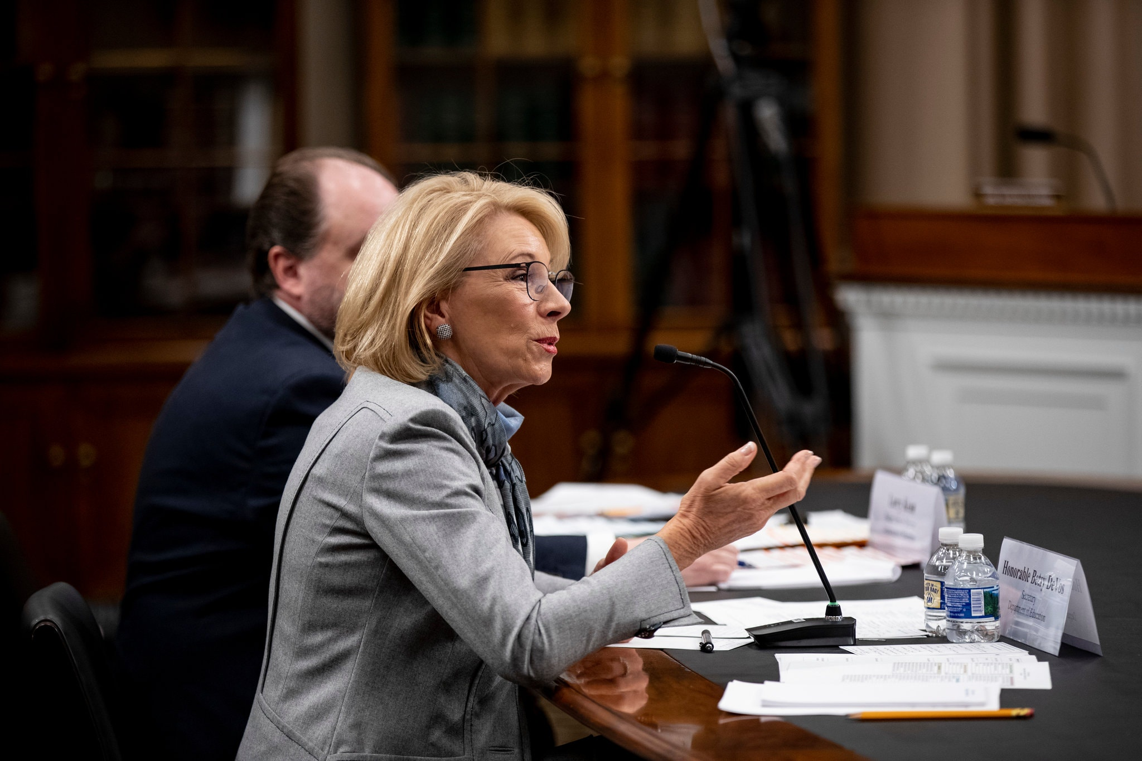
What’s Next? She’s GONE, But her rules are still here!!

Slide 26
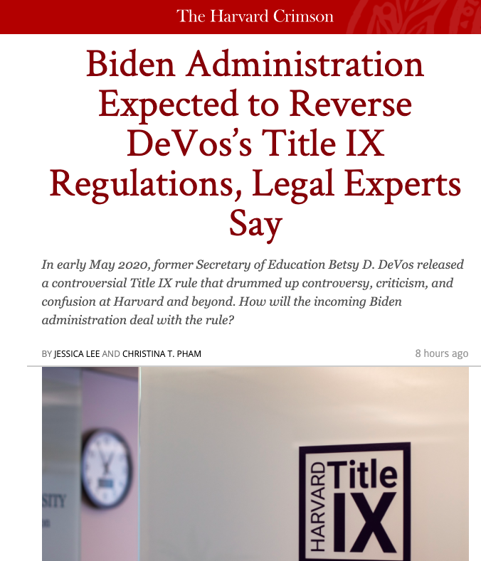
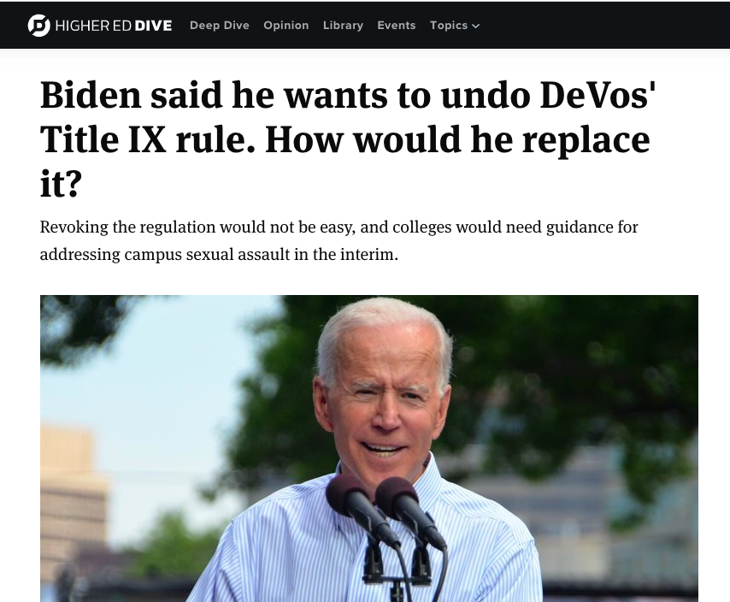

Slide 27
October, 2023

Slide 29
DeVos: 2020 Definition and scope of Sexual Harassment under Title IX
Prior Guidance: Previous guidance from the Department of Education required schools to investigate any “unwelcome conduct of a sexual nature”
Now Universities must only respond to “Sexual harassment” as defined in the regulations much more narrowly,
Now only includes
(1) the conditioning of an aid, benefit or service of the institution on an individual’s participation in unwelcome sexual conduct (i.e., quid pro quo);
(2) unwelcome conduct determined by a reasonable person to be so severe, pervasive and objectively offensive that it effectively denies a person equal access to the institution’s education program or activity;
and (3) sexual assault, dating violence, domestic violence and stalking.
Occurring within a school’s education program or activity; and b) within the United States
.
Notes:
MARJY, NEW RULE REQUIRES BEHAVIOR TO BE MUCH, MUCH WORSE to trigger a University response…AND IS FAR HARDER TO PROVE.
Narrows scope of universities’ responsibility to respond to cases of sexual harassment.

Slide 30
May a school respond to alleged sexual misconduct that does not meet the definition of sexual harassment in the 2020 amendments?
The preamble to the new regulations says that “nothing in the final regulations precludes [a school] from vigorously addressing misconduct (sexual or otherwise) that occurs outside the scope of Title IX or from offering supportive measures to students and individuals impacted by misconduct or trauma
“Title IX is not the exclusive remedy for sexual misconduct or traumatic events that affect students.”
A school has discretion to respond appropriately to reports of sexual misconduct that do not fit within the scope of conduct covered by the Title IX grievance process. This may include, for example, reported sexual misconduct that a) occurs outside of a school’s education program or activity; b) occurs outside of the United States; or c) causes harm in the school environment that does not fit within the definition set out above

Slide 31
Presumption: Respondents Not responsible
Presumption that the respondent is not responsible for the alleged conduct until a determination regarding responsibility is made at the conclusion of the grievance process.
Regulations’ “presumption of non-responsibility” requires schools to investigate and resolve complaints: “without drawing inferences about credibility based on a party’s status as a complainant or respondent.”
Burden of proof and burden of gathering evidence sufficient to reach a determination
regarding responsibility rests on the school and not on the parties!

Slide 32
Title IX Cases vs Gender Based misconduct policy cases
Title IX Policy: On Campus/In US/Student here or intending to return
Vs.
The Gender-Based Misconduct Policy governs certain gender-based misconduct involving University students that:
● occurs on or off any University campus or
in connection with University programs or activities;
● creates a hostile environment; or
● involves an accused person who is a current undergraduate, graduate, or professional school student at the University.

Slide 33
Two Policies now…
On May 19, 2020, the U.S. Department of Education issued an updated set of regulations under Title IX that more narrowly defines sexual harassment and addresses how institutions must respond to reports within that definition.
These regulations do not cover all of the types of misconduct or places in which misconduct occurs that Columbia believes must be addressed in keeping with our own non-discrimination commitment and our obligations under state and local law. For this reason, the University now has two policies: the Interim Title IX Policy and the Gender-Based Misconduct Policy.
Under both the Interim Title IX Policy and the Gender-Based Misconduct Policy, the University remains committed to diligently investigating reports of misconduct, supporting students and others who experience gender-based misconduct, and responding fairly and firmly when students violate University policy.
Could have an appeal that falls under either of the two policies.

Slide 34
Tech?
Discussions on Zoom or on the Phone.
https://cuit.columbia.edu/zoom#/text-13566

Slide 35
And, New York’s Enough is Enough Law…

Slide 36
Scope of the policy
The policy applies to all types of relationships:
Casual, Long-term, Marriages
Umbrella term used to describe a broad range of behaviors:
Sexual Harassment
Gender-Based Harassment
Dating Violence
Domestic Violence
Stalking
Sexual Exploitation
Sexual Assault: Penetration
Sexual Assault: Contact
Notes:
“Gender-Based Misconduct” – it may sound a bit more vague than “Sexual Violence Response” ……what exactly does that mean? The term “gender-based misconduct” is an umbrella term, and in the next slide we’re going to review the various definitions so that you have a sense of the type of behaviors we’re investigating in our office.
The Policy applies to all student affiliates of Columbia University, whether they are studying here on the Morningside Heights Campus, or they’re studying abroad in China. As long as you’re an affiliated student of this University, you are covered under this Policy.
Gender-based misconduct can occur among individuals regardless of their relationship status/duration, their gender identity, or their particular racial or other protected identifying class.

Slide 37
Gender-Based Misconduct Policy for Students and Interim Title IX Policy: Prohibited Acts
Sexual Assault: Intercourse
Sexual Assault: Contact
Domestic Violence
Dating Violence
Sexual Exploitation
Stalking
Sexual Harassment
Gender-Based Harassment
Retaliation
Affirmative consent
Incapacitation

Slide 38
Policy Definitions of Gender-Based Misconduct
Sexual Assault: Penetration Any form of sexual intercourse without affirmative consent.
Intercourse is: vaginal penetration (however slight) by a penis, object, tongue, or finger; anal penetration by a penis, object, tongue or finger; and oral copulation (mouth to genital contact or genital to mouth contact)
Sexual Assault: Contact Any intentional sexual touching for the purpose of sexual gratification without affirmative consent.
Sexual touching includes contact under or over clothing with the breasts, buttocks, genitals, groin, or touching another with any of these body parts, or making another person touch any of these body parts
Notes:
You may want to stress the difference in sexual intercourse definition from what they may know or understand – Columbia’s Policy definition is more expansive and broad than other legal definitions you may be familiar with.

Slide 39
Affirmative Consent: The Bedrock of Columbia’s Policy
Our policy (and New York State Legislation) states:
“Affirmative consent is a knowing, voluntary, and mutual decision among all participants to engage in sexual activity. Consent can be given by words or actions, as long as those words or actions create clear permission regarding willingness to engage in the sexual activity. Silence or lack of resistance, in and of itself, does not demonstrate consent. The definition of consent does not vary based upon a participant's sex, sexual orientation, gender identity, or gender expression.”
Notes:
Consent is the backbone of our policy. This is our policy definition of consent, consistent with NYS law.
Columbia implemented an affirmative consent requirement before this recent legislation, it has simply now been codified for all institutions of higher education that receive state funds and directly incorporated (word-for-word) into our Policy.
Marjy will talk about this more in next presentation

Slide 40
What Does It Mean to be Incapacitated?
When someone cannot make rational, reasonable decisions because they lack the capacity to give knowing consent (e.g., to understand the “who, what, when, where, why or how” of the sexual interaction)
If you are “incapacitated” you may NOT be able to understand that you can decide NOT to consent to sex.
Incapacity can result from a person’s consumption of alcohol and/or other drugs, disability, being physically constrained, or sleep.
If I have had a few drinks, can I still consent?
It’s a continuum! You can be intoxicated, and tipsy, and still able to consent, or incapacitated and almost unconscious, and unable to consent.
Notes:
Ask for definition from group: difference between intoxication, incapacitation, and black out. It is a spectrum.
“Out cold” on the one end and “totally fine” on the other
Where is the line between the two?
How about on verge of losing consciousness?
How about enough drinks to be a little “high”?
When does impaired judgment become incapacitation?
Is it when you are “legally” intoxicated, i.e., over .08 BAC?
Intoxication is not the same thing as incapacitation

Slide 41
How might someone respond to the immediate threat of assault?
Fight
Flight
Freeze
Negotiate
Accommodate

Slide 42
What might the complainant be feeling or thinking immediately after the assault?
Confused, angry, embarrassed, humiliated
Incapable of action, frozen, can’t decide what he/she should do
Foggy memory or no memory at all
Reliving the event
Feeling angry and violated or sad and depressed
Thinking things like:
This isn't supposed to happen to me.
I can't believe he/she did that! I actually liked him/her and trusted him/her.
What did I do to make him/her think that was ok?
Why didn't he/she listen to me?
Feeling friends and family unsupportive, whether or not they are
Anxiety over costs associated with trauma
Sense of betrayal, loss of trust/safety in community he/she was attached to

Slide 43
Rape Trauma Syndrome
Group of symptoms in response to sexual assault
Sexual assault includes, rape, sodomy and sexual abuse
Form of post-traumatic stress disorder (PTSD)
DSM-V TR
Sexual assault is one of the listed stressors which can cause PTSD
Be cognizant that this MAY account for complainant’s conduct during the assault and during first report.

Slide 44
Signs of Trauma
Disorganization
Difficulty concentrating
Irritability, anger, temper or flat affect
Horror, shame, sadness
Reluctance and ambivalence, no shows
Health decline
Difficulty with sleeping
Destructive coping behaviors
Disassociation and confusion
Intrusive thoughts
Nightmares
Flashbacks
Delayed reporting

Slide 45
How might these reactions affect students when they make a report, in the interview, or during an investigation?
Delay in acknowledging/reporting that trauma happened
Compromised ability to function academically or socially
Unexpected emotional affect: going blank, giggling or “freezing”
No-show at appointments
If show up, tell story in a non-linear way.
There is no consistent or “normal” reaction

Slide 46
How might someone feel if they are accused of a sexual assault?
Will this be a criminal investigation or a Title IX investigation?
Could I go to jail?
Could I get kicked out of school?
Could this end up in the media?
Will everyone find out?
How will others here at school view me? People at home?
Will I have to change dorm rooms, change class schedule, leave campus altogether?
Should I have a lawyer?
Should I even talk to you, or to the Title IX investigator?
Should I tell my parents?
Depression, anger, fear

Slide 47
However….
Even witnesses and respondents who do not appear to have experienced trauma (e.g., many respondents), may be experiencing substantial stress due to investigation and interview setting
As with complainants, should not rely unduly on “presentation as evidence”

Slide 48
From Title IX Regulation Preamble:
“The Department’s interest in ensuring impartial Title IX proceedings that avoid prejudgment of the facts at issue necessitates a broad prohibition on sex stereotypes so that decisions are made on the basis of individualized facts and not on stereotypical notions of what ‘‘men’’ or ‘‘women’’ do or do not do.”
Regulations’ “presumption of non-responsibility” requires schools to investigate and resolve complaints: “without drawing inferences about credibility based on a party’s status as a complainant or respondent.”
In other words, if you see signs of PTSD it does not necessarily mean that the account is truthful or not; investigators should keep investigating.

Slide 49
Overview of GBM Policies/Procedures
Snapshot of policies and procedures for Appellate Panel members

Slide 50
Possible Resolutions under GBM and Interim Title IX Policy
Investigation and Adjudication
Composition and training
Evaluation of information
Informal or Alternative Resolution: No punitive sanction
Mediation
Facilitated conversation or caucus mediation
Action agreement between parties
Restorative Justice
Identify the harms and reconcile with the persons or community
Admission required

Slide 51
Resolving Reports: Gender Based Misconduct Cases
Receipt of report of gender-based misconduct
Outreach by Case Management to the parties
Discussion of possible resolutions
Investigation conducted
Factual Summary of Investigative Report distributed to parties
Pre-Determination Conference held
(parties provided opportunity to present the investigators with questions for the other party and/or witnesses; any necessary additional investigation conducted)
Investigative Report with recommendations of responsibility and credibility assessment distributed to parties and hearing panel
Pre-Hearing Conference held
Hearing conducted (if necessary)
Determination by the hearing panel
Notice of sanctions, if applicable
Appeals by either party
Notice of a filed appeal
Parties’ review and response to an appeal
Decision by the appellate panel

Slide 52
Procedural Requirements for Investigations: Title IX and GBM
Notice TO BOTH PARTIES
Equal opportunity to present evidence
An advisor of choice
Written notification of meetings, etc., and sufficient time to prepare
Opportunity to review ALL evidence, and 10 days to submit a written response to the evidence prior to completion of the report
Report summarizing relevant evidence and 10 day review of report prior to hearing
Notes:
Do not spend time here, next few slides get into each of these

Slide 53
How is the Investigation Conducted?
Parties are interviewed by a team of investigators
Witnesses suggested by the parties are interviewed, including outcry witnesses
Documentary evidence reviewed
Social media, texts, emails, photos analyzed
Investigators must circle back to the parties at conclusion of all interviews
Credibility Assessment
Recommendation of responsibility issued
Hearing panel decides whether or not Respondent is responsible for violating the Policy

Slide 54
Common Types of Evidence considered by the investigator and the panel
Testimony
Social Media Posts and messages
Emails
Videos
Surveillance
Photographs
Police Body Camera Footage
Swipe Records
Medical Records
Phone Records
Audio Recordings
Text Messages
Notes:
Investigation Time line- look at pre assault behavior

Slide 55
What is the Ultimate Issue?
Is there a preponderance of the evidence to prove that a violation of the policy occurred?
More likely than not that this happened?

Slide 56
The Credibility Assessment
The investigator’s report submitted to the panel receives must be able to support, and articulate why the investigators can, or cannot recommend that there is a preponderance of the evidence one way or another.
If the evidence is not so persuasive either way, then Hearing Panel can’t reach a preponderance.
The Hearing Panel must be able to articulate why they are deciding that one version is more compelling than the other, in other words, their rationale for the decision.

Slide 57
Evaluating Credibility: What does the Investigator/Hearing Panel Rely Upon?
Uses various factors to evaluate the credibility of all the witnesses interviewed
consistency or inconsistency of accounts of events over time;
potential for bias in favor of a specific party or outcome;
any corroborating evidence; and
reasonable and logical statements, (or lack thereof) including statements about details associated with the allegations

Slide 58
Ultimately, the investigator’s decision relies heavily upon the consistency or inconsistency of their account of events.
Has the version of events remained consistent since the first time they were disclosed?
Are there discrepancies?
Seek explanations for the inconsistencies, if they exist, and determine whether the explanation makes sense.

Slide 59
Corroboration? Not absolutely necessary but helpful.
Whether other corroborative evidence exists
Independent witnesses
Photographs, texts, emails, phone calls, Instagram, Snapchat, video surveillance footage
Physical evidence
Is account contradicted by other evidence, and if so does it undermine their credibility?

Slide 60
Difficult issues in investigations under EIE and Interim Title IX Cases
Prohibited for investigator to inquire about:
Sexual History
Psychiatric Issues

Slide 61
Prior Sexual history. GBM
Sexual History
Either the Complainant or the Respondent may provide information regarding their shared sexual history.
Generally, the Investigative Team will not consider information concerning the Complainant’s or the Respondent’s sexual history with other people, except under very limited circumstances such as explaining an injury or responding to another specific question raised by an allegation.

Slide 62
Prior sexual History: Title IX
Either the Complainant or the Respondent may provide information regarding their shared sexual history.
Questions and evidence regarding the Complainant’s prior sexual behavior are generally irrelevant and prohibited, subject to two limited exceptions:
(1) where evidence of prior sexual behavior is offered to prove someone other than the Respondent committed the alleged offense,
or (2) where prior sexual behavior evidence is specifically about the Parties’ shared sexual history and is offered to prove consent.
If either Party offers such information, the other will have the right to respond.

Slide 63
Medical/mental health History under interim Title IX policy
Any Party’s medical, psychological, or similar records cannot be accessed, considered, disclosed, or otherwise used as part of this investigative process without the Party’s voluntary, written consent.
Each Party has the right to request that evidence regarding their mental health diagnosis and/or treatment be excluded from consideration on the basis that it is not relevant to the allegations.
You may see some redactions
However, if an individual wishes to present evidence of their own mental health diagnosis and treatment, they may do so in limited circumstances. If either Party offers this type of information for consideration, the other Party will be notified and can request that the information not be considered.

Slide 64
Hearings: GBM
Panel evaluates and analyzes all relevant information in the Investigative Report
Panel reviews any relevant submissions and information presented by the parties in the hearing process
Panel determines whether additional investigation needs to be conducted by the Investigative Team
If additional information required, it is referred back to investigation
Preponderance of the evidence standard still applies
Hearing process involves statements by the parties and questions by the panel, but does not include witness testimony

Slide 65
The panel will Identify and rely only upon the Relevant Evidence
Notes:
When writing your report, don’t even look at the portion of the record that includes irrelevant information.

Slide 66
Relevant Questions
A relevant question seeks to elicit relevant information:
That demonstrates a logical connection between the facts at issue
That will make a fact more or less probable,
About a fact that is of consequence in determining the action

Slide 67
When is evidence relevant?
Logical connection between the evidence and facts at issue
Assists in coming to the conclusion – it is “of consequence”
Tends to make a fact more or less probable than it would be without that evidence
Notes:
Step one often involves assessing the parties’ and witnesses’relative credibility

Slide 68
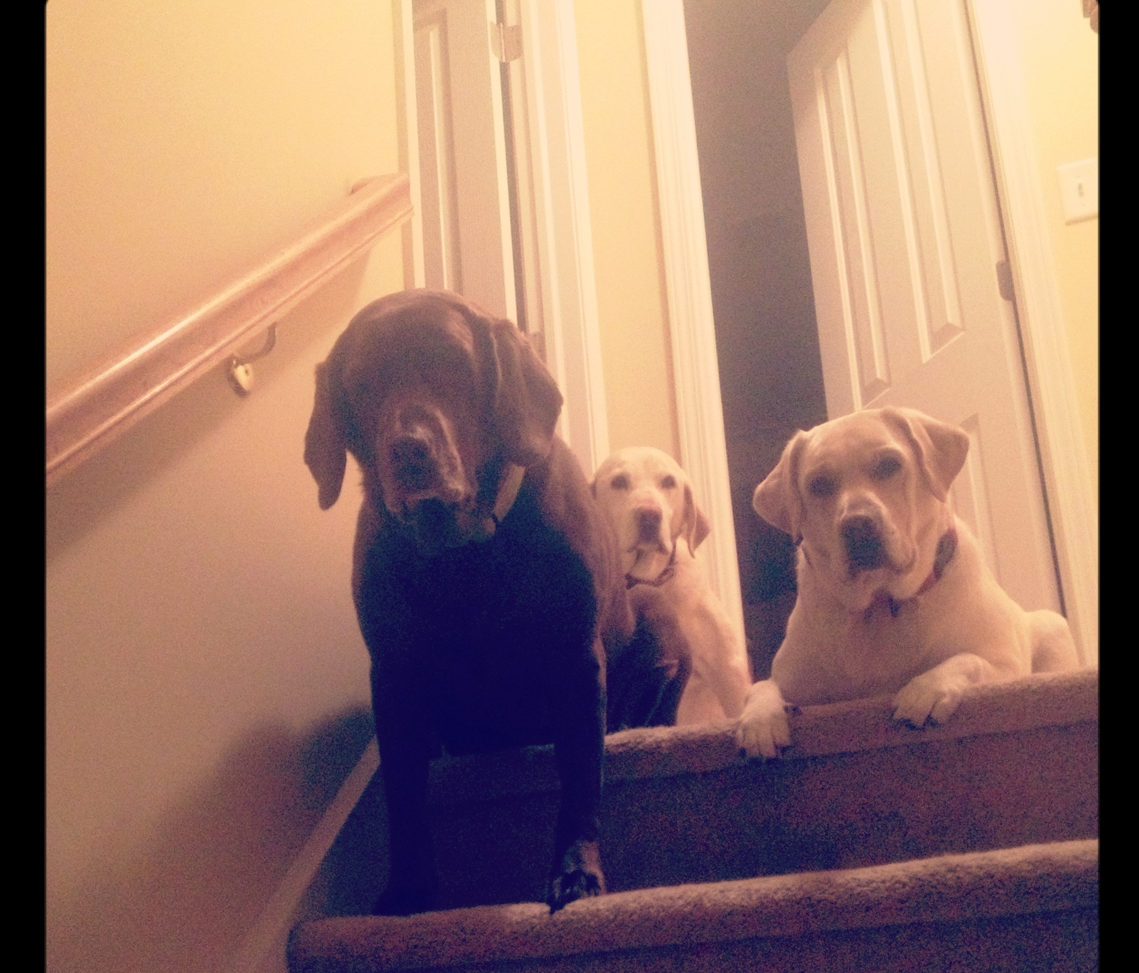
Preponderance of the Evidence
More likely than not.
Does not mean 100% true or accurate.
A finding of responsibility = There was sufficient reliable, credible evidence to support a finding, by a preponderance of the evidence, that the policy was violated.
A finding of not responsible = There was not sufficient reliable, credible evidence to support a finding, by a preponderance of the evidence, that the policy was violated.
Notes:
Rebecca

Slide 69
50% AND A

Slide 70
Witnesses and Cross Examination: Only in Interim Title IX Hearings
The parties’ advisors must be given the opportunity to ask relevant questions of the opposing party and all witnesses, and to ask relevant follow up questions.
Only in an interim Title IX case
Likely to change under new regulations issued by Biden administration.

Slide 71
Questioning of the Parties and Witnesses by advisors only

Slide 72
Questions?
Notes:
https://forms.gle/ugAHrbQLokJMWzRz9

